Slide 1
Scientific writing
With thanks to the Duke Graduate School Scientific Writing Resource
https://cgi.duke.edu/web/sciwriting/

Slide 2


Slide 3
simplicity

Slide 4
Put actions in verbs
Action
To regulate
To analyze
To occur
To understand
To investigate
Nominalization
Regulation
Analysis
Occurance
Understanding
Investigation

Slide 5
Put actions in verbs
We performed an analysis on the data.
We analyzed the data.

Slide 6
Put characters in subjects
The character is the actor.
Readers expect the main character in a clause to be found in the subject.

Slide 7
Put characters in subjects
The movement in the liquid medium of the bacteria was accomplished by the microflagellum.
The bacteria move themselves in the liquid medium with the microflagellum.

Slide 8
Put characters in subjects
The movement in the liquid medium of the bacteria was accomplished by the microflagellum.
The bacteria move themselves in the liquid medium with the microflagellum.

Slide 9
Put characters in subjects
Several primate genomes are needed to identify features common to primates or unique to humans.
Identification of features common among primates or unique to humans will require several primate genomes.

Slide 10
Put characters in subjects
Several primate genomes are needed to identify features common to primates or unique to humans.
Identification of features common among primates or unique to humans will require several primate genomes.

Slide 11
Keep subjects near verbs
Farmers that understand the difference between the soil requirements of plants when they are seedlings and their requirements when they are mature are in high demand.
Farmers are in high demand if they can understand the difference between the soil requirements of plants when they are seedlings and their requirements when they are mature.

Slide 12
Use passive voice judiciously
Active: The dog chased the ball.
Passive: The ball was chased by the dog.

Slide 13
Coherence
The “flow” of writing.
When writing is coherent, it stays on topic in expected units.
Readers expect thoughts to be expressed in paragraph units.
One paragraph = one thought.
Each sentence in that paragraph should support the main point.

Slide 14
Topic sentences
Every paragraph. No exceptions.

Slide 15
Omit needless words
Ineffectual phrases: “The intent of those who use ineffectual phrases is to make it appear as though their sentences are more substantial than they actually are, but not one sentence is made more meaningful by their inclusion.”

Slide 16
Omit needless words
Ineffectual phrases:
Note that…
It should be noted that…
It is important to realize…
Studies have shown…
In order to…

Slide 17
Omit needless words
Instead of:
a large majority of
has the capacity to
whether or not
are in agreeement
prior to
subsequent to
at this point in time
due to the fact that
in the event that
a new initiative
nearly unique
plays a key role in
both cultures were equally affected
Use:
most
can
whether
agree
before
after
now
because
if
an initiative
unique
is essential to
the cultures were equally affected

Slide 18
Prefer simple words / use plain English
Bad writers consider long words more impressive than short ones.
- John Lynch

Slide 19
Use plain English
Instead of:
elucidate
utilize
methodology
etiology
Use:
show
use
method
cause

Slide 20
Use simple subjects
The sequences that had passed our filtering, trimming, and alignment with ClustalX, were scanned for conserved elements across mammals.
The sequences were trimmed, filtered, and aligned with ClustalX. The resulting alignments were scanned for conserved elements across mammals.

Slide 21
Use adjectives/adverbs frugally
“completely and utterly alone”
“utterly alone”
“alone”

Slide 22
Avoid excessive hedging
These results suggest that our method may possibly identify putative enhancer elements.

Slide 23
Avoid excessive hedging
These results suggest that our method may possibly identify putative enhancer elements.

Slide 24
Avoid demeaning adverbs
“Obviously”
“Clearly”
“Undoubtedly”

Slide 25
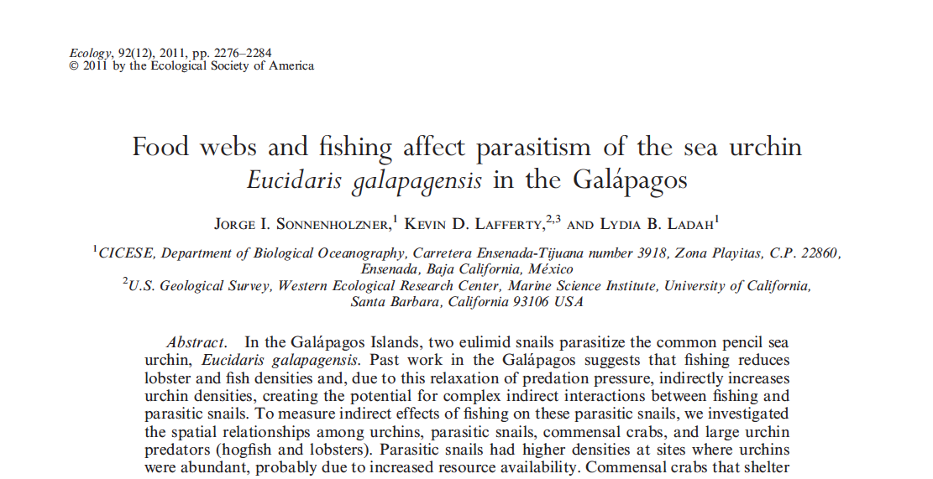
Hook

Slide 26
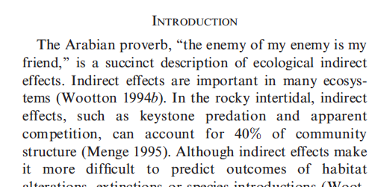
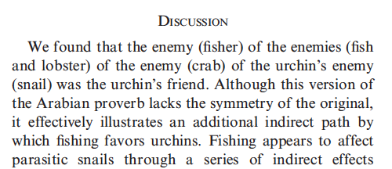

Slide 27
simplicity

