Slide 1
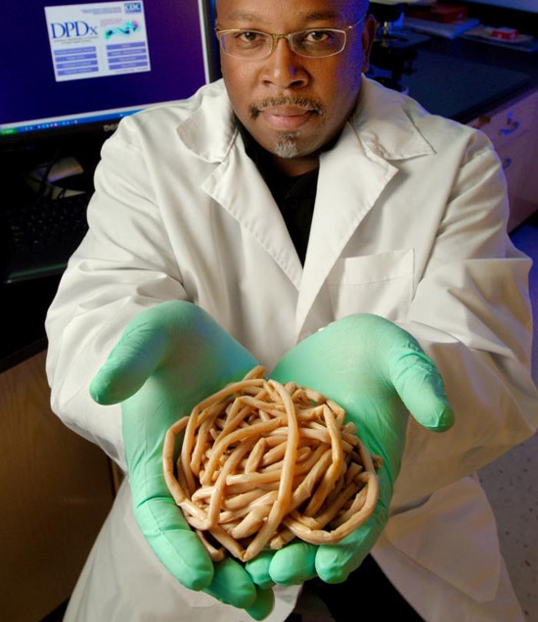
Welcome to
FISH 406:
Parasite Ecology
Bob
Bell

Slide 2
FISH 406
Parasite Ecology
Autumn 2021
    Instructor: Dr. Chelsea Wood
    TA: PhD student Sara Faiad
    Chelsea’s office hours: 1:30-2:30pm Wednesdays
    Email: chelwood@uw.edu
    Sara’s office hours: 2-5pm Wednesdays
    Email: sfaiad@uw.edu

Slide 3
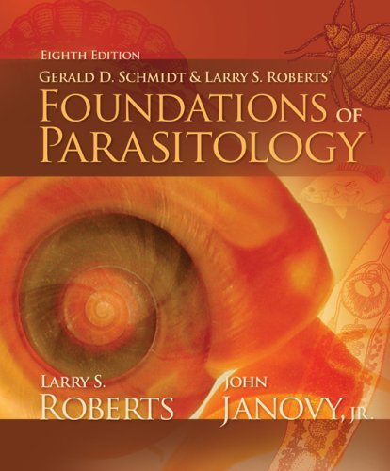

required text
+ readings from

Slide 5
class norms
growth mindset
respect and support one another
actively listen
contribute
ask questions
monitor air time

Slide 7
let’s dive in…
Bob
Bell

Slide 8
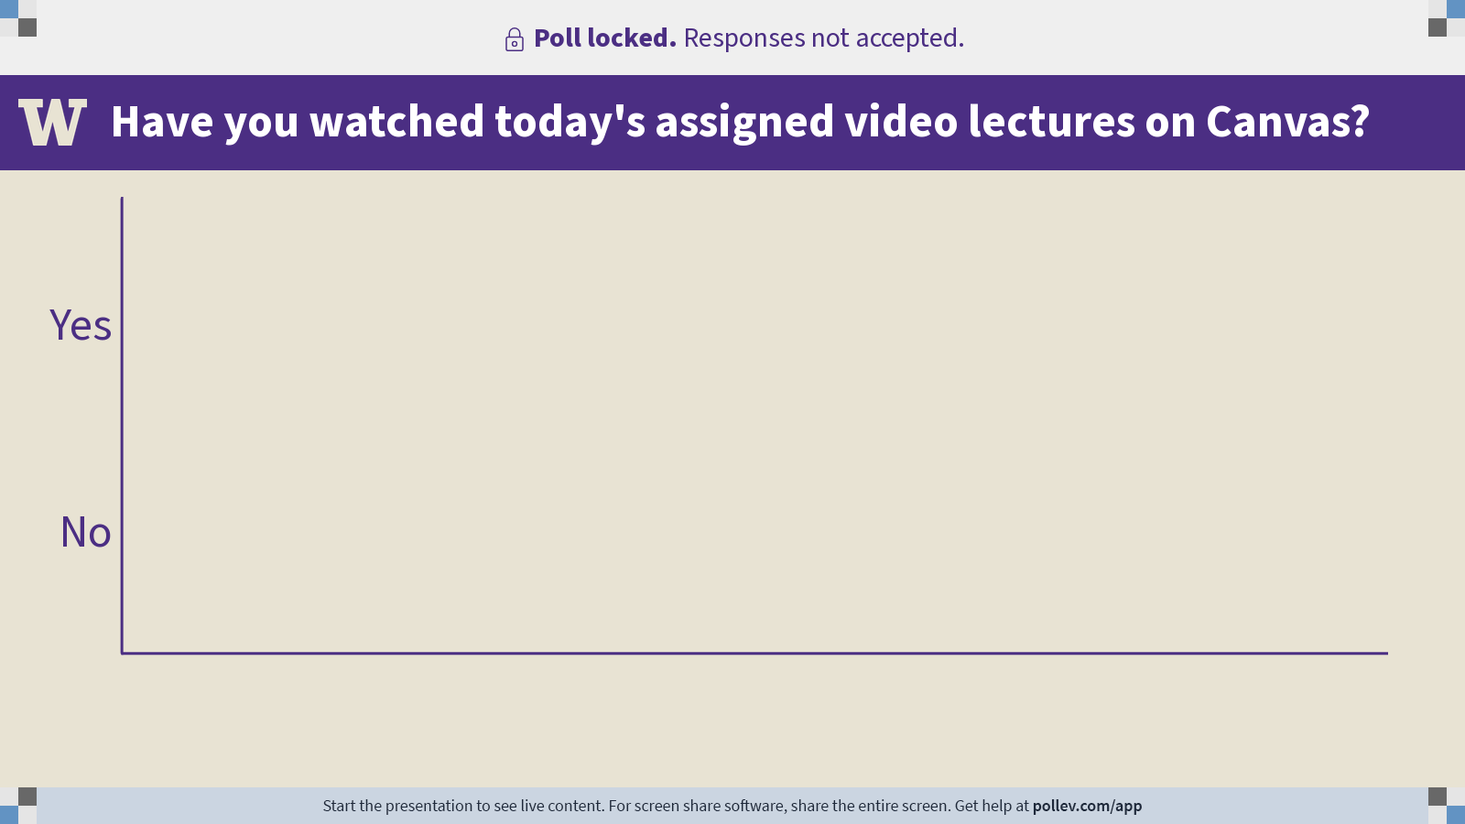
Notes:
Do not modify the notes in this section to avoid tampering with the Poll Everywhere activity.
More info at polleverywhere.com/support
Have you watched today's assigned video lectures on Canvas?
https://www.polleverywhere.com/multiple_choice_polls/dmDhSArseQCVNTRIZbh1g?flow=Default&onscreen=persist

Slide 9
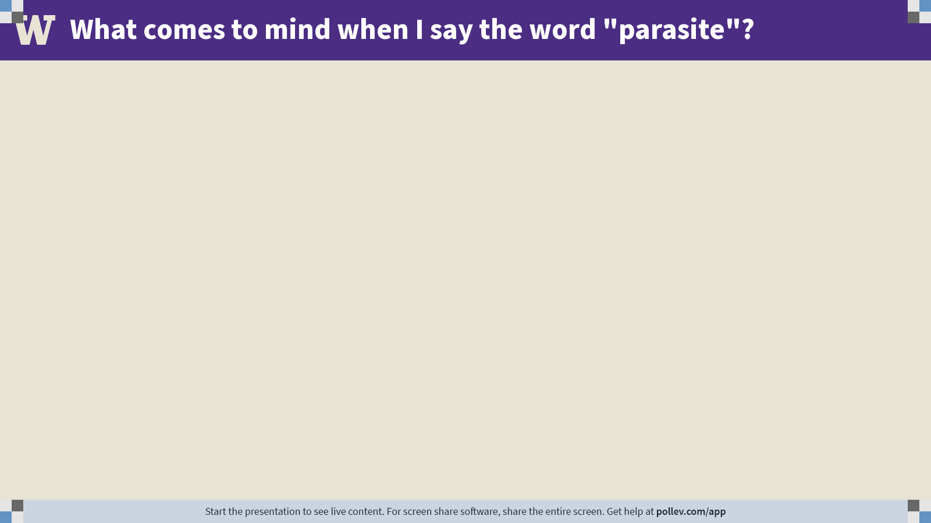
Notes:
Do not modify the notes in this section to avoid tampering with the Poll Everywhere activity.
More info at polleverywhere.com/support
What comes to mind when I say the word "parasite"?
https://www.polleverywhere.com/free_text_polls/n8mRsosII42qUWMLxN3aH

Slide 10
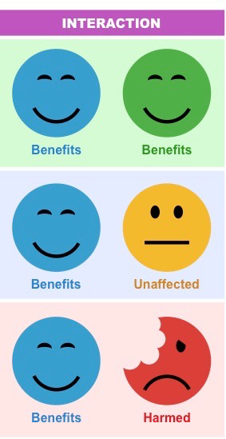
parasites on the spectrum of symbiosis
Parasites are not the only organisms that live in intimate and durable relationships with their hosts.
The class will be split into groups.
Each group will be assigned one kind of symbiont: parasites, commensals, or mutualists.
Generate as many examples of the assigned symbiont as you can.
Each person should assume one role:
  Note-taker (in Google doc)
  Timekeeper
  Reporter
Collaborate with your group to come up
with as many examples as you can.
Notes:
https://docs.google.com/document/d/1Kk92IApqR0dqP8pjU8KjXSjuFePxToeInctn_EKyqx0/edit?usp=sharing

Slide 11
Welcome to
FISH 406:
Parasite Ecology
Bob
Bell

Slide 12
Practical session 1:
This wormy world

