Slide 1
Practical session 10: Nematodes 1

Slide 2
Q1. The geohelminths have been co-evolving with humans for a long, long time. What are some cultural practices that might have arisen because they protect human populations against geohelminth infections?

Slide 3
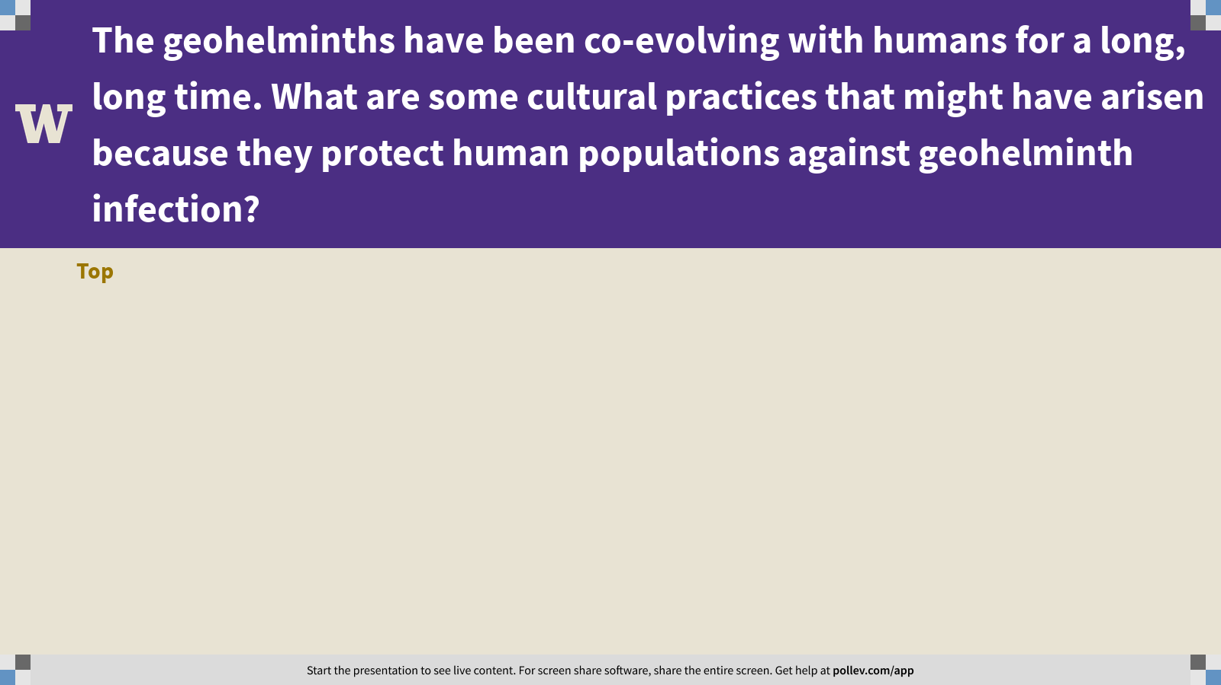
Notes:
The geohelminths have been co-evolving with humans for a long, long time. What are some cultural practices that might have arisen because they protect human populations against geohelminth infection?
https://www.polleverywhere.com/discourses/4txOezA5bPCKs28stVXCK

Slide 4
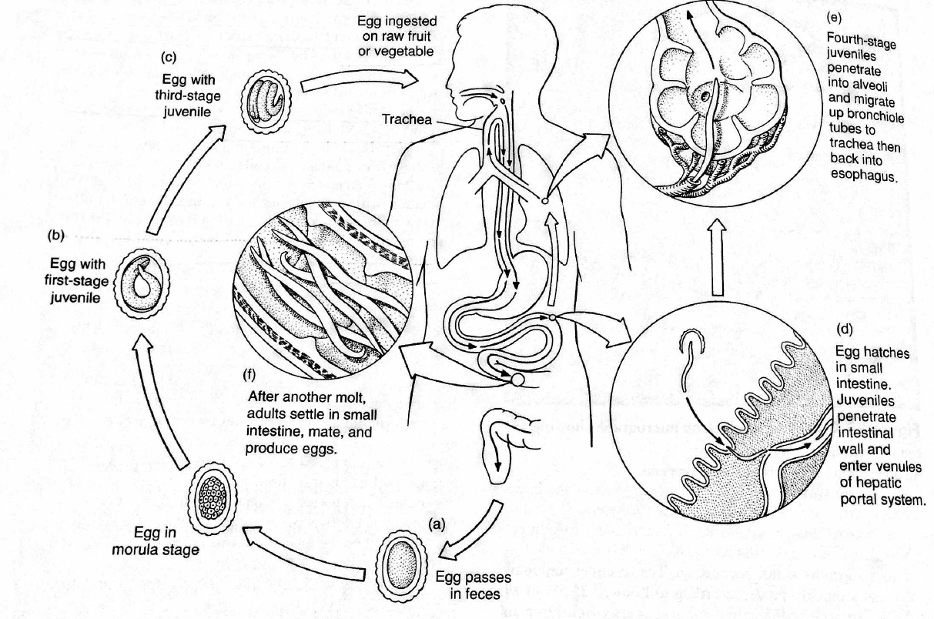

Slide 5

Q2. the life cycle of Ascaris lumbricoides
The life cycle of Ascaris lumbricoides is counterintuitive in the extreme. Why on Earth does this intestinal parasite leave the intestine to make a long and pointless migration through the circulatory system?
Ponder on your own (3 m), develop a plan with your group (5 m), then share with the class (5 m).

Slide 7
Q3. Ascaris eggs are tough because of their thick mammilated layer. What are some of the conditions that Ascaris eggs can survive that might kill other parasite eggs?

Slide 8
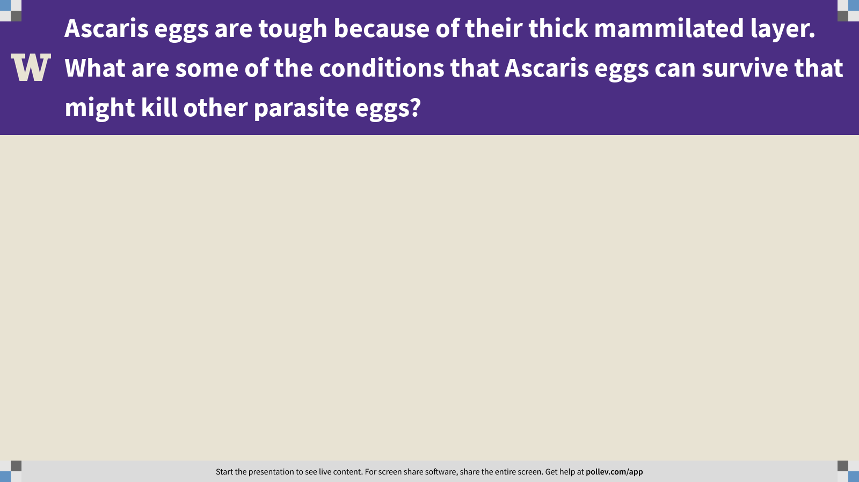
Notes:
Ascaris eggs are tough because of their thick mammilated layer. What are some of the conditions that Ascaris eggs can survive that might kill other parasite eggs?
https://www.polleverywhere.com/free_text_polls/QZcnVvoAIKBGctyctG1KM

Slide 9
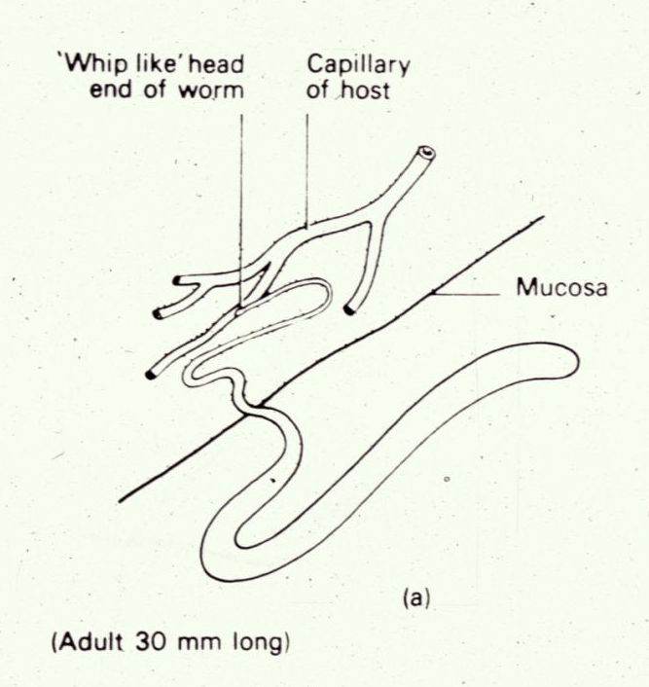
Q4. pathology of Trichuris trichiura
Trichuris trichiura doesn’t take that much blood from its host, but its pathology can be severe nonetheless, due to the damage it causes to the intestinal epithelium. Why is damage to the intestinal epithelium bad? List as many reasons as you can.
Ponder on your own (3 m), discuss with a partner (5 m), then share with the class (5 m).

Slide 10
Q4. pathology of Trichuris trichiura
Notes:
Changes in any attribute of a population over time.
Evolutionary change leads to adaptation and must involve a change in the frequency of individual genes in a population from generation to generation.

Slide 11
Practical session 10: Nematodes 1

