Slide 1
Practical session 13: Nematodes 4

Slide 2

Q1. why are there so many parasites in Africa?
At this point in the course, we’ve discussed a dozen or so parasites that are found primarily in sub-Saharan Africa. Why do there seem to be so many parasite species in Africa?
Write on your own (3 m), hone a final answer with your group (4 m), then share with the class (5 m).

Slide 3
Q1. why are there so many parasites
in Africa?
Notes:
Changes in any attribute of a population over time.
Evolutionary change leads to adaptation and must involve a change in the frequency of individual genes in a population from generation to generation.

Slide 4
Q2. Onchocerca volvulus declines in abundance as deforestation increases, setting up a “win-lose” outcome for people and nature. Mega bummer. Can you think of other parasites where there is instead a ”win-win” outcome? That is, situations where conserving biodiversity leads to reductions in transmission of a parasite?

Slide 5
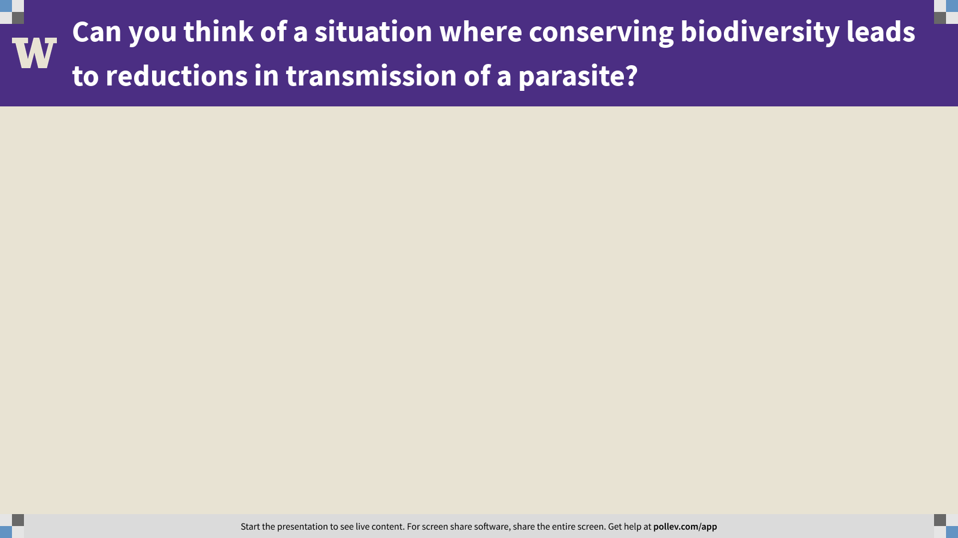
Notes:
Can you think of a situation where conserving biodiversity leads to reductions in transmission of a parasite?
https://www.polleverywhere.com/free_text_polls/BaO0w2q2CLfTm6kq40q3t

Slide 6
Q3. design a study to reveal one parasite’s history
At this point in the course, we’ve discussed several parasites that were introduced into Latin America from Africa during the Atlantic slave trade. What we haven’t talked about is the evidence for this.
How would you test whether Onchocerca volvulus was introduced into Latin America via the Atlantic slave trade?
Write on your own (3 m), hone a final answer with your group (4 m), then share with the class (5 m).

Slide 7
Q3. design a study to reveal
one parasite’s history
Notes:
Changes in any attribute of a population over time.
Evolutionary change leads to adaptation and must involve a change in the frequency of individual genes in a population from generation to generation.

Slide 8
Practical session 13: Nematodes 4

