Slide 1
Practical session 16: Arthropods 1

Slide 2
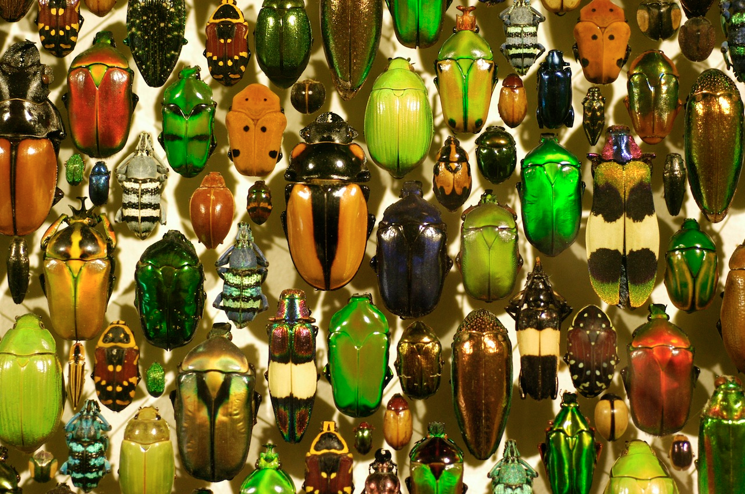

Q1. why so many arthropods?
Arthropods are the most successful group of animals on Earth. They are also pretty successful among the parasites. What traits account for this success?
Ponder on your own (2 m), discuss with your group
(3 m), then share with the class (7 m).

Slide 3
Q1. why so many arthropods?
Notes:
Changes in any attribute of a population over time.
Evolutionary change leads to adaptation and must involve a change in the frequency of individual genes in a population from generation to generation.

Slide 4
Q2. design your own vector
You are a bacterium that is parasitic in whale sharks but you are terrible at being transmitted through water. You need a vector.
Consider the traits that make a good vector.
Design your vector:
  Draw it
  Draw its life cycle
  Explain why this life cycle makes it a good vector for you.
Ponder on your own (2 m), discuss with your group
(5 m), then share with the class (7 m).

Slide 5
Q3a. Acari or not?

Slide 6

Notes:
Acari or not?
https://www.polleverywhere.com/multiple_choice_polls/f2kmJTnvE7dnnQA8p7ZzO?flow=Default&onscreen=persist

Slide 7
Q3b. Acari or not?

Slide 8
Notes:
Acari or not?
https://www.polleverywhere.com/multiple_choice_polls/f2kmJTnvE7dnnQA8p7ZzO?flow=Default&onscreen=persist

Slide 9
Q3c. Acari or not?

Slide 10
Notes:
Acari or not?
https://www.polleverywhere.com/multiple_choice_polls/f2kmJTnvE7dnnQA8p7ZzO?flow=Default&onscreen=persist

Slide 11
Practical session 16: Arthropods 1

