Slide 1
Practical session 17: Arthropods 2

Slide 2
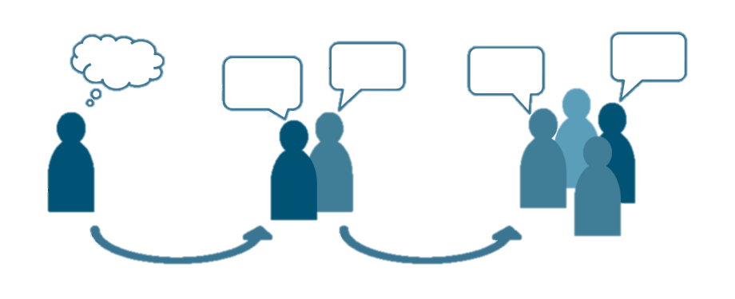
Q1. Lice
We’ve talked a lot about the conditions under which human lice tend to thrive. But where do you think you find the largest populations of lice in nature? Among what host species? In what habitats? At what places and times?
Ponder on your own (2 m), discuss with your group
(3 m), then share with the class (7 m).

Slide 3
Colpocephalum californici
the California condor louse

Slide 4
Q2. Until recently, bed bugs weren’t known to transmit ANY human disease. Now we know that they are capable of transmitting the protozoan that causes Chagas’ disease. Given what you know about the phylogeny, biology, and ecology of bed bugs, what OTHER human diseases are the likeliest candidates for transmission by bed bugs?

Slide 5
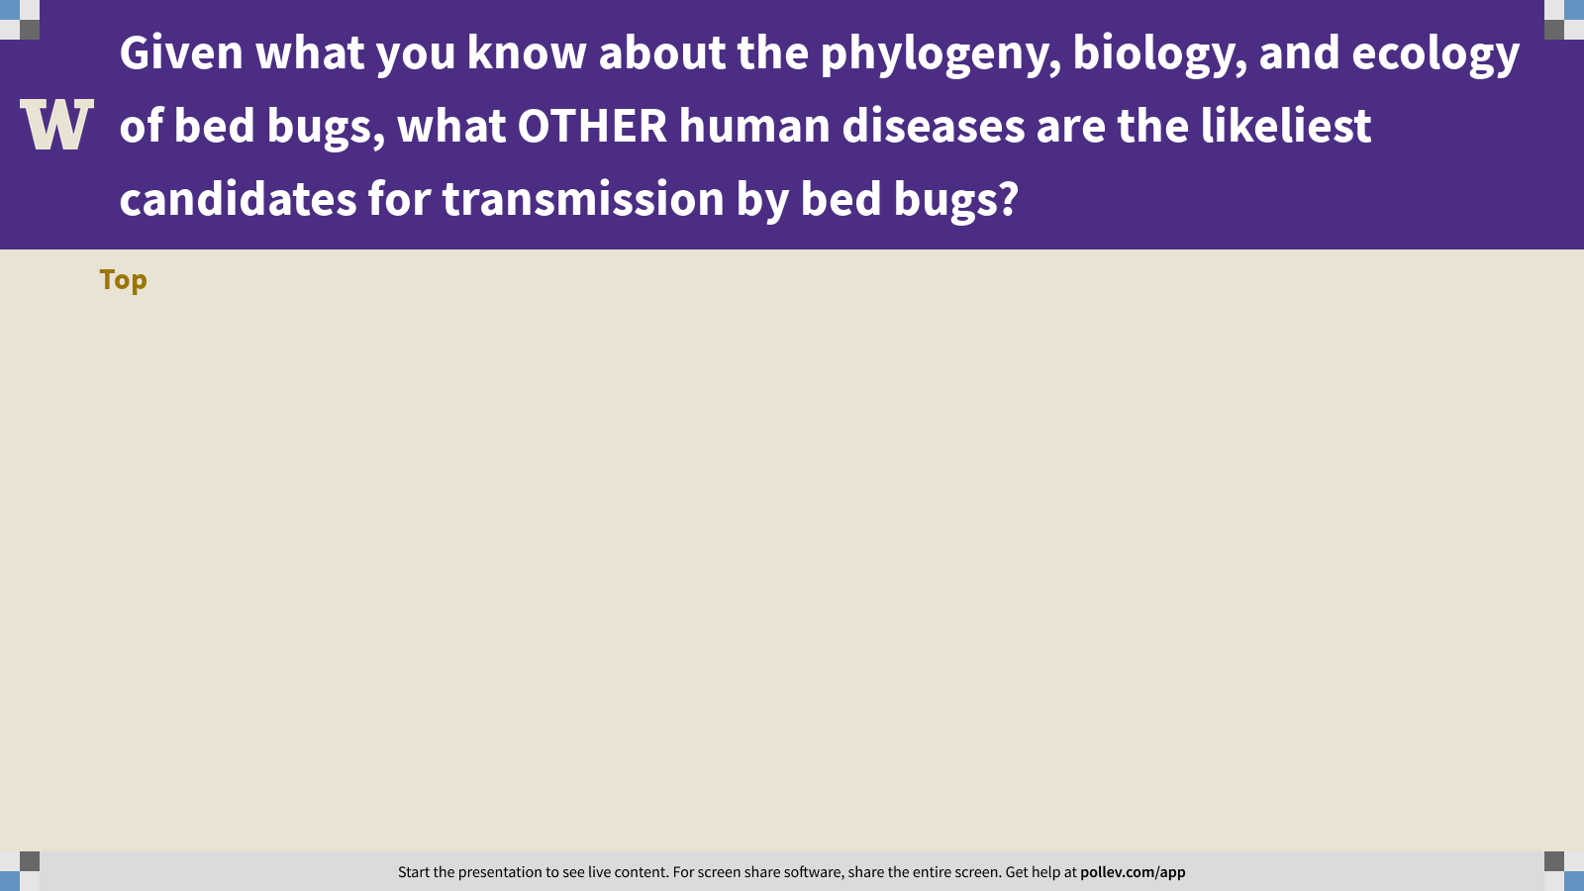
Notes:
Given what you know about the phylogeny, biology, and ecology of bed bugs, what OTHER human diseases are the likeliest candidates for transmission by bed bugs?
https://www.polleverywhere.com/discourses/VtK9A1KAtdiz7rfYLk6Mu

Slide 6
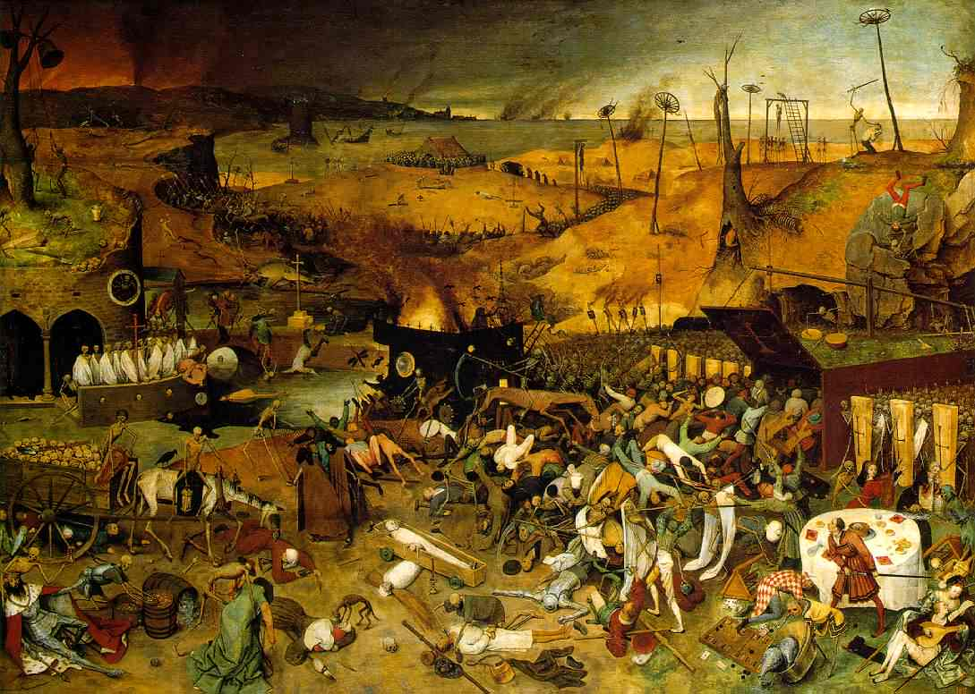
Q3. Black Death
What were the historical/ecological conditions that set the stage for the 14th century Black Death? Generate as many ideas as you can think of.
Ponder on your own (2 m), discuss with your group
(3 m), then share with the class (7 m).

Slide 7
Q2. Black Death
Notes:
Changes in any attribute of a population over time.
Evolutionary change leads to adaptation and must involve a change in the frequency of individual genes in a population from generation to generation.

Slide 8
Practical session 17: Arthropods 2

