Slide 1
Practical session 18: Arthropods 3

Slide 2
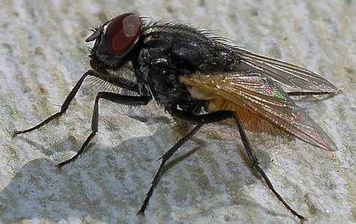
Order Diptera (flies)
Family Muscidae
common house fly
synanthropic
not vectors, but do carry disease.
how?
  hairy
  sticky foot pads
  love human food and human poo
  move easily between indoor and outdoor

Slide 3
Q1. Given what you know about parasites transmitted by contact with feces, what human diseases do you think might be transmitted when house flies visit human food?

Slide 4
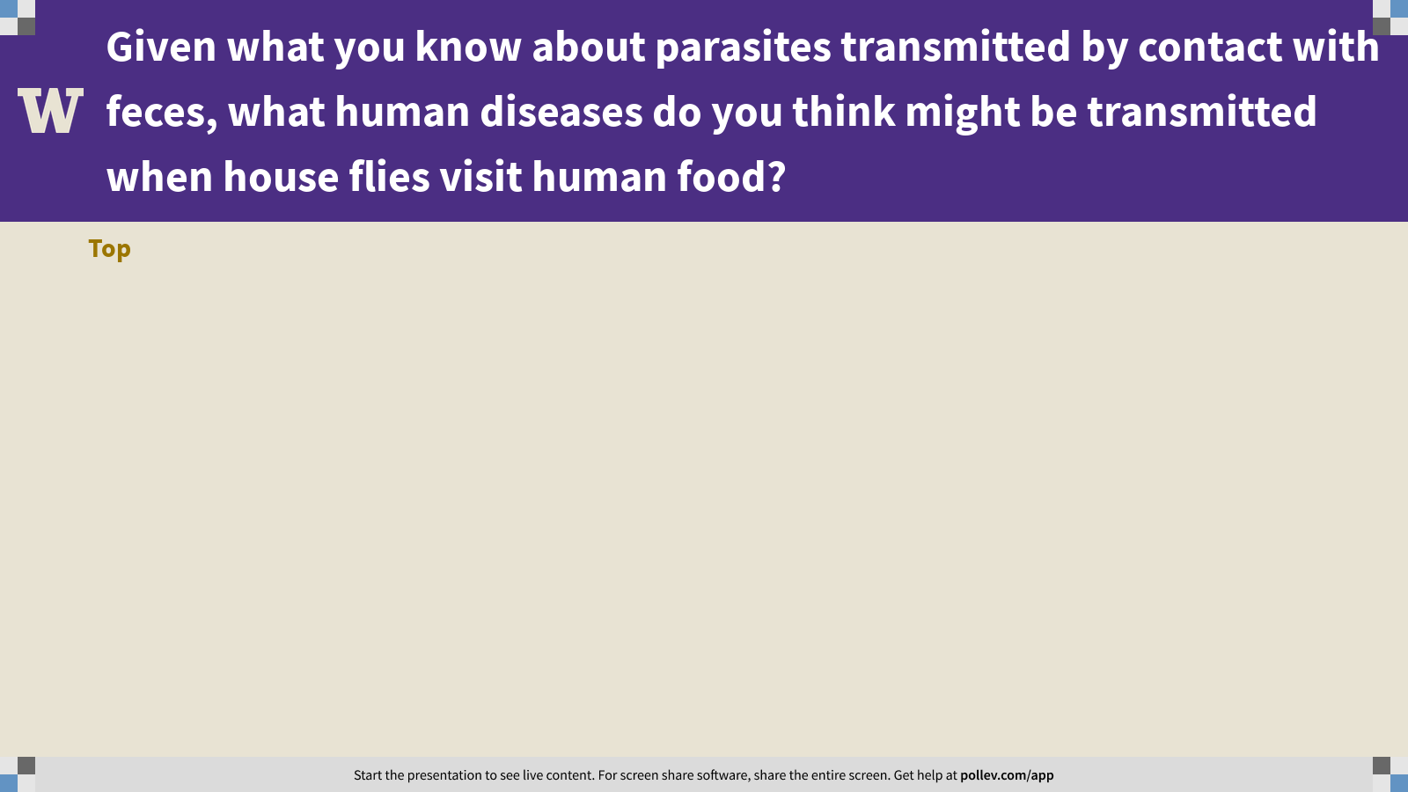
Notes:
Given what you know about parasites transmitted by contact with feces, what human diseases do you think might be transmitted when house flies visit human food?
https://www.polleverywhere.com/discourses/uZydAugABrYsqkLVtKDwv

Slide 5
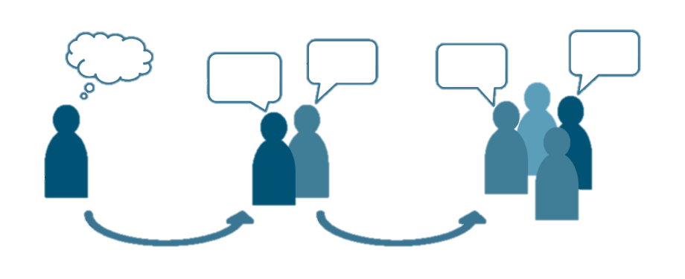
Q2. biological control
In Edwards and Leung 2009, you read about efforts to eradicate an invasive tunicate. You are tasked with designing a biological control intervention for achieving this goal. How will you do it?
Ponder on your own (2 m), discuss with your group
(3 m), then share with the class (7 m).

Slide 6
Q2. biological control
Notes:
Changes in any attribute of a population over time.
Evolutionary change leads to adaptation and must involve a change in the frequency of individual genes in a population from generation to generation.

Slide 7
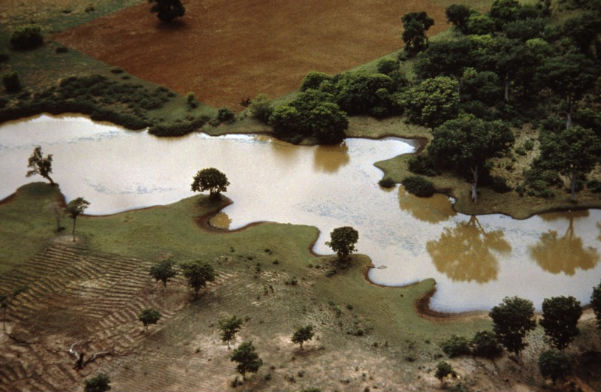
Q3. ecology of onchocerciasis
You are in charge of a forest restoration project in East Africa. Your job is to make sure that there are no negative human health consequences of this restoration project. How do you proceed?
Ponder on your own (2 m), discuss with your group
(3 m), then share with the class (7 m).

Slide 8
Q3. ecology of onchocerciasis
Notes:
Changes in any attribute of a population over time.
Evolutionary change leads to adaptation and must involve a change in the frequency of individual genes in a population from generation to generation.

Slide 9
Practical session 18: Arthropods 3

