Slide 1
Practical session 2: Adaptations to parasitism and introduction to the trematodes

Slide 2

Q1. food conversion efficiency in parasites
Although tapeworms have a reputation for causing weight loss or wasting in their hosts, each worm takes very little energy from its host and uses what energy it takes very efficiently. Brainstorm possible answers to the following questions:
Why are tapeworms so efficient?
Why don’t hosts have food conversion efficiencies equal to those of their parasites?
Work out the answer on your own.
Then compare answers with a partner.

Slide 3
Q1. food conversion efficiency in parasites
Notes:
Changes in any attribute of a population over time.
Evolutionary change leads to adaptation and must involve a change in the frequency of individual genes in a population from generation to generation.

Slide 4
Q2. who has it easier?
Life always forces trade-offs, but those trade-offs look different for parasites than they do for free-living species. Who has it better for each of the following processes – free-living species or parasitic species? Why?
Popping out babies
Dispersing to a new habitat
Surviving in your environment
Increasing your body size
Acquiring food
Avoiding the extinction of your species
Work out the answer on your own.
Then compare answers with a partner.

Slide 5
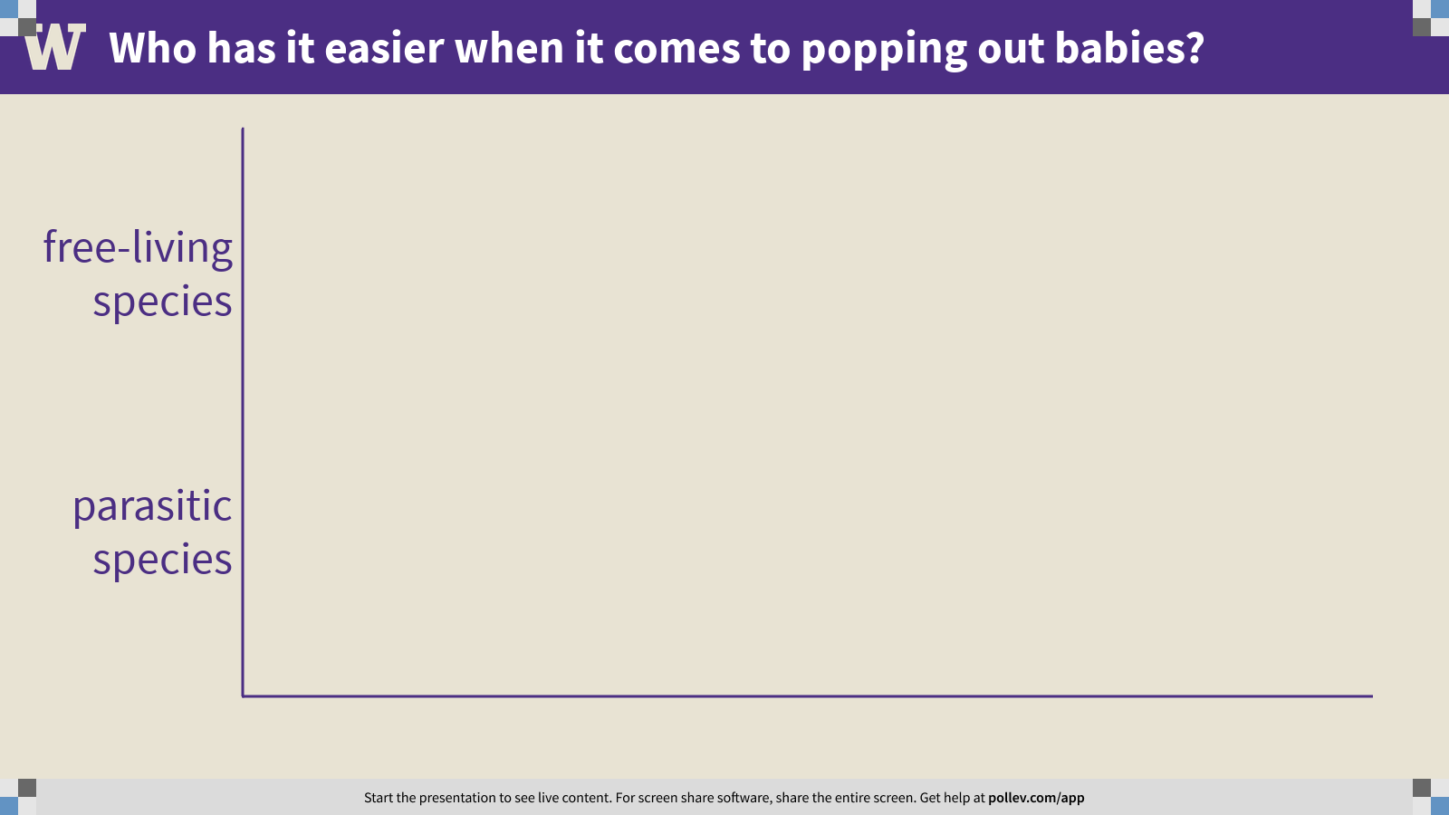
Notes:
Who has it easier when it comes to popping out babies?
https://www.polleverywhere.com/multiple_choice_polls/yX1dNBrTy4p1UBYoJhbrq?flow=Default&onscreen=persist

Slide 6
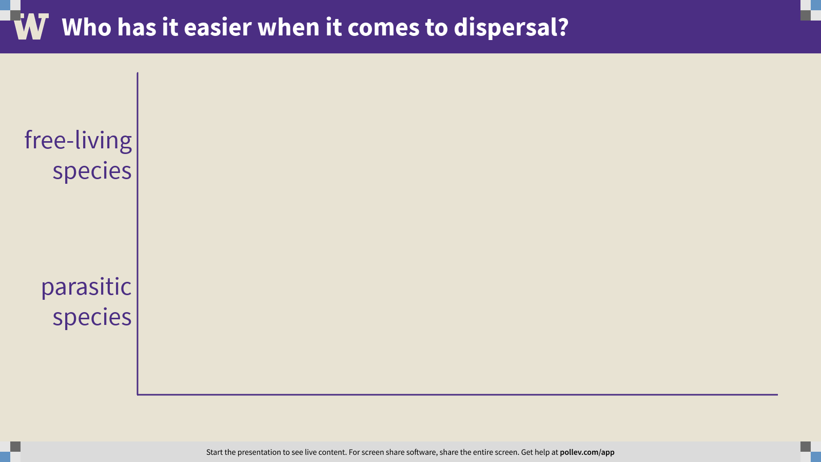
Notes:
Who has it easier when it comes to dispersal?
https://www.polleverywhere.com/multiple_choice_polls/0E0bZ4i1St4IxFjJ2AwXs?flow=Default&onscreen=persist

Slide 7
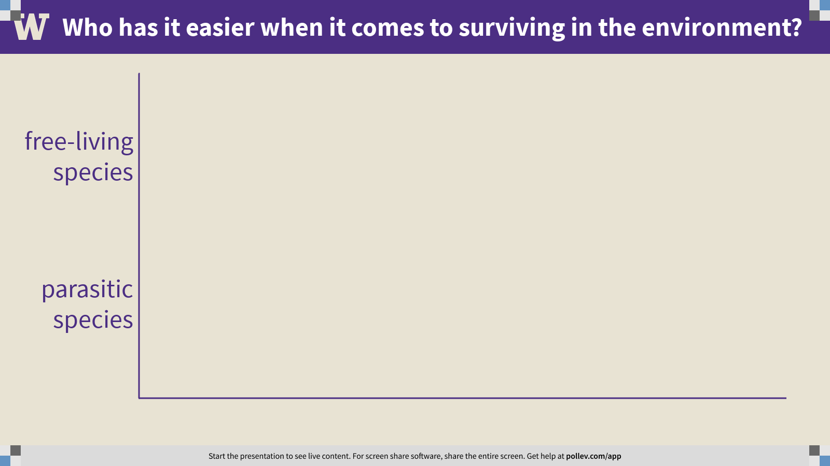
Notes:
Who has it easier when it comes to surviving in the environment?
https://www.polleverywhere.com/multiple_choice_polls/c75ZVabcHpxN7bTwJKWLb?flow=Default&onscreen=persist

Slide 8
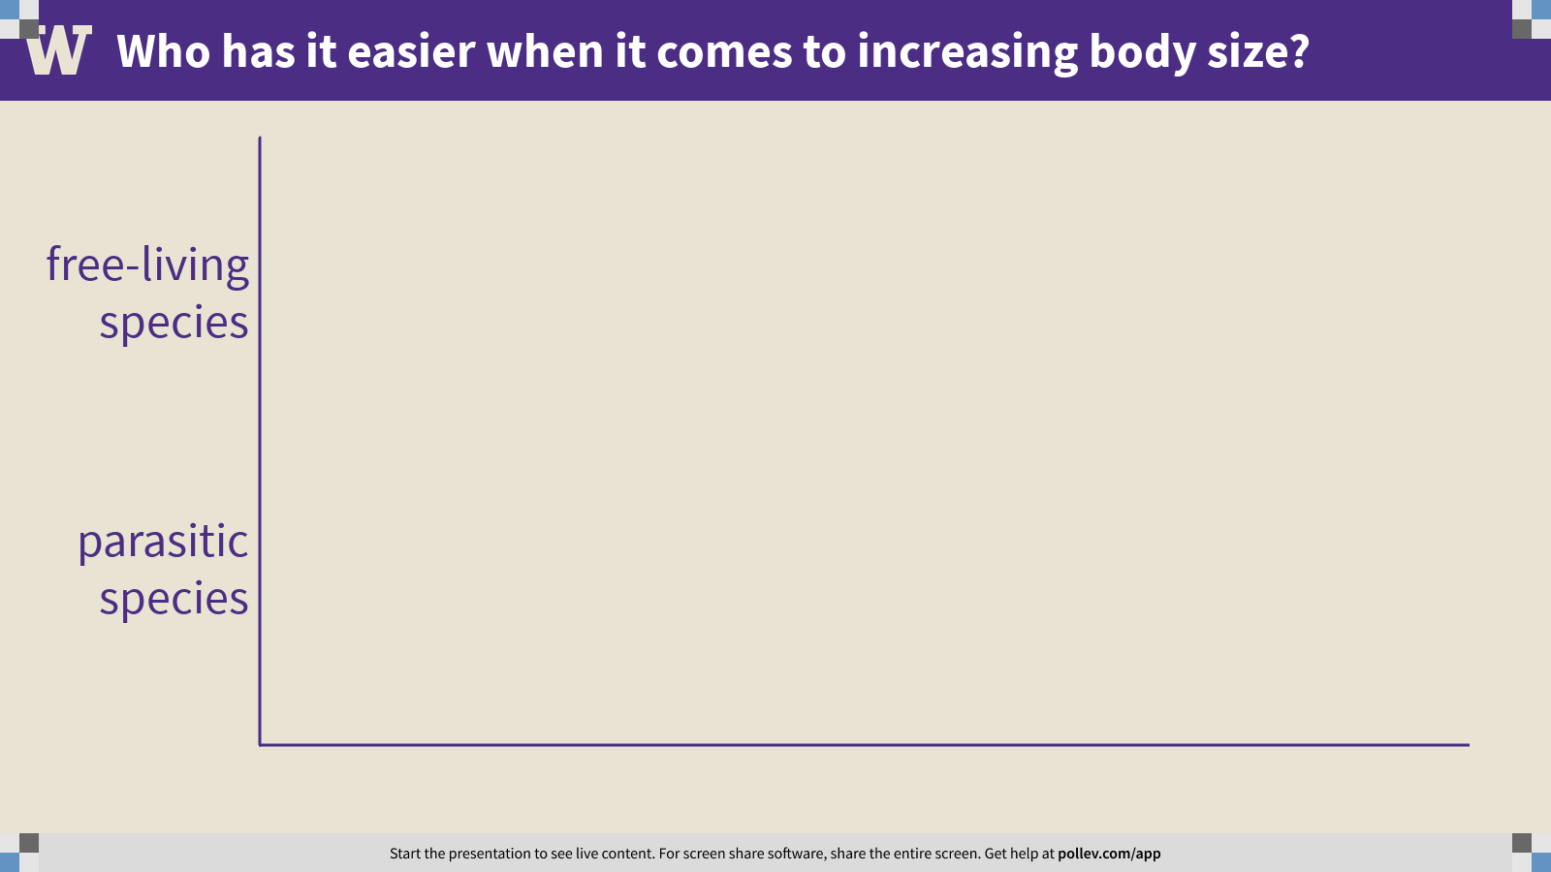
Notes:
Who has it easier when it comes to increasing body size?
https://www.polleverywhere.com/multiple_choice_polls/LmqHs6H1dWdE0h1aEiCtB?flow=Default&onscreen=persist

Slide 9
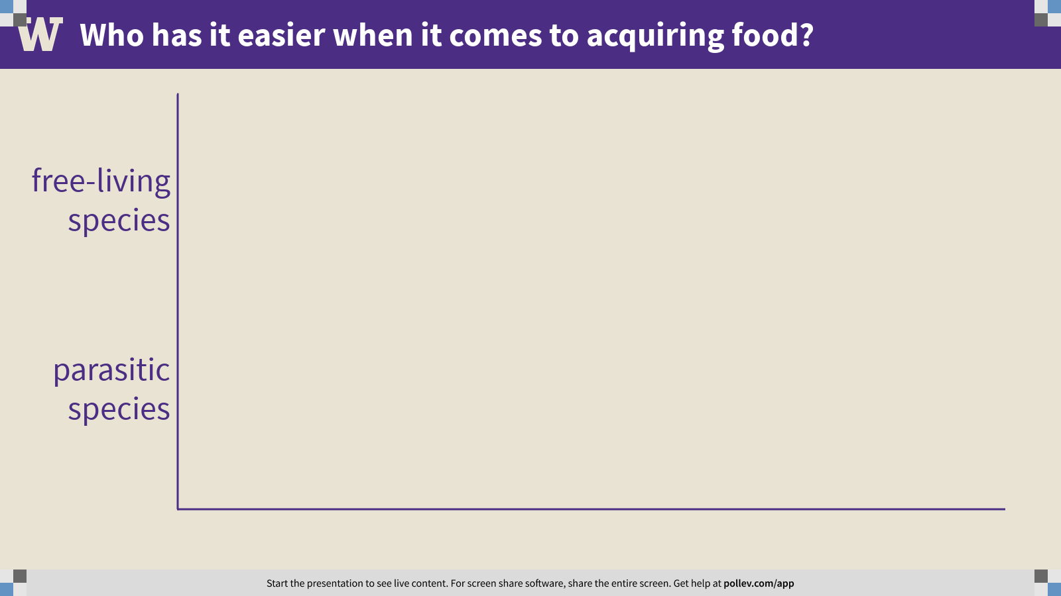
Notes:
Who has it easier when it comes to acquiring food?
https://www.polleverywhere.com/multiple_choice_polls/shfhRBHLRmCQG9QXDwBgt?flow=Default&onscreen=persist

Slide 10
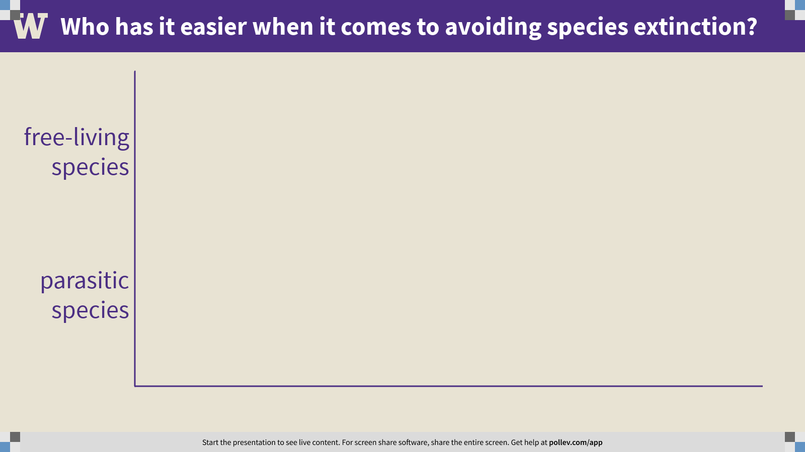
Notes:
Who has it easier when it comes to avoiding species extinction?
https://www.polleverywhere.com/multiple_choice_polls/ePU9YsG7NCRM9THKWXCnW?flow=Default&onscreen=persist

Slide 11
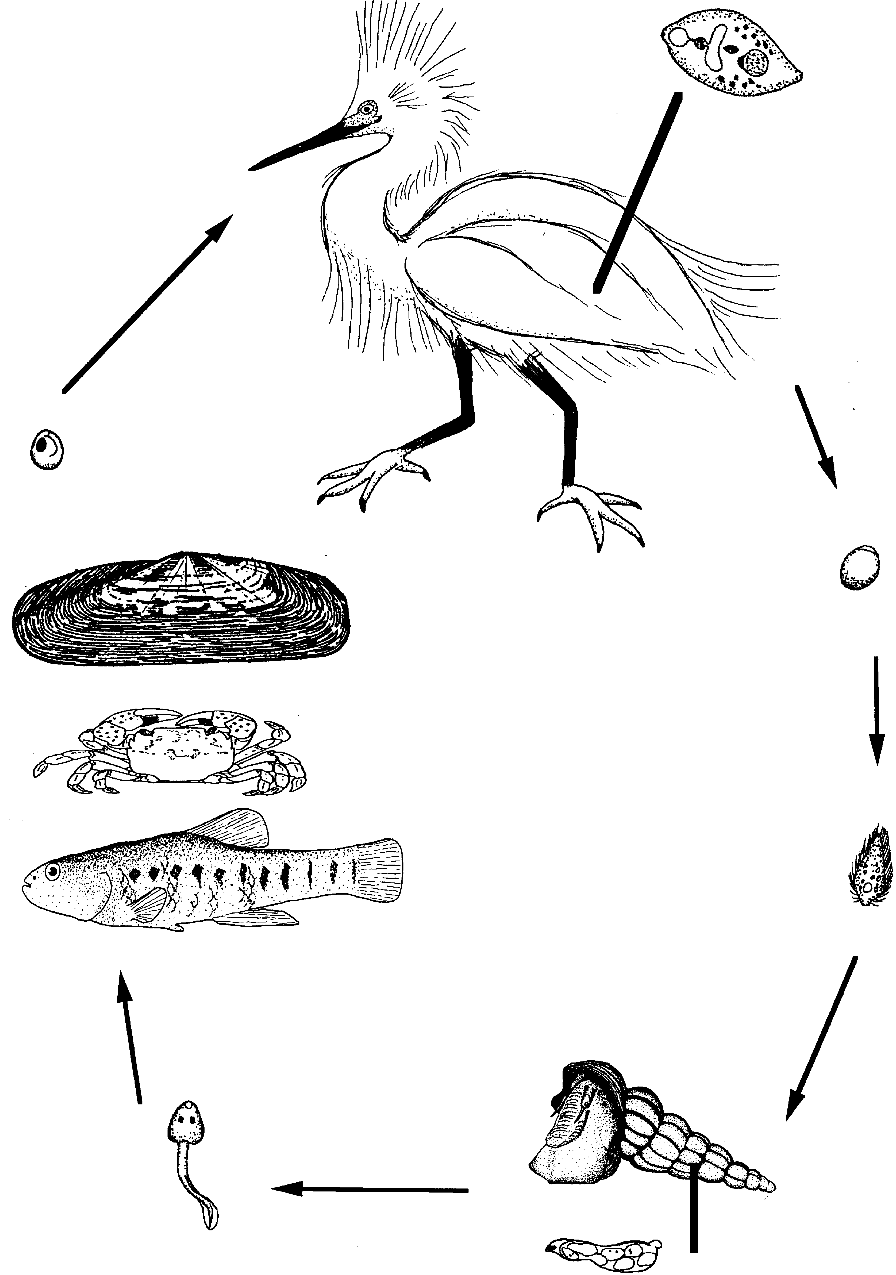

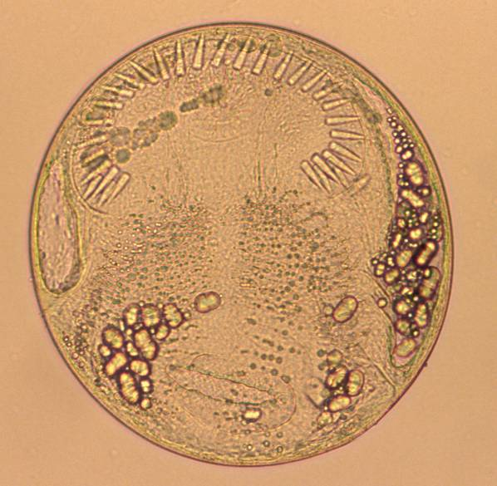
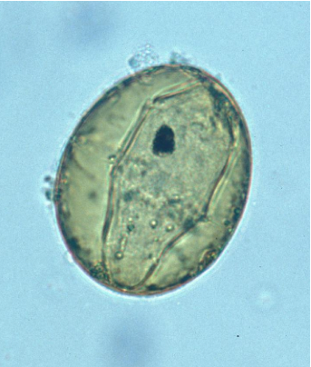

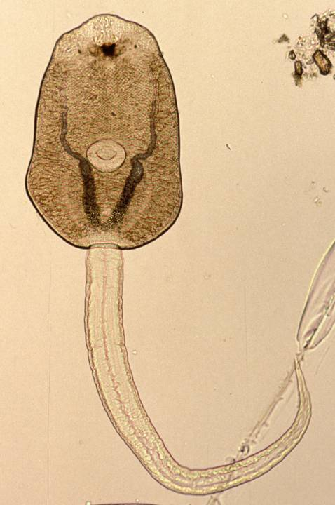
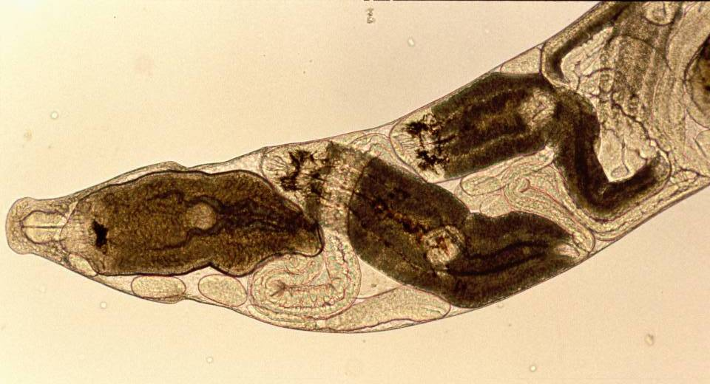
metacercaria
adult
definitive host
second intermediate hosts
egg
cercaria
miracidium
first intermediate host
redia

Slide 12
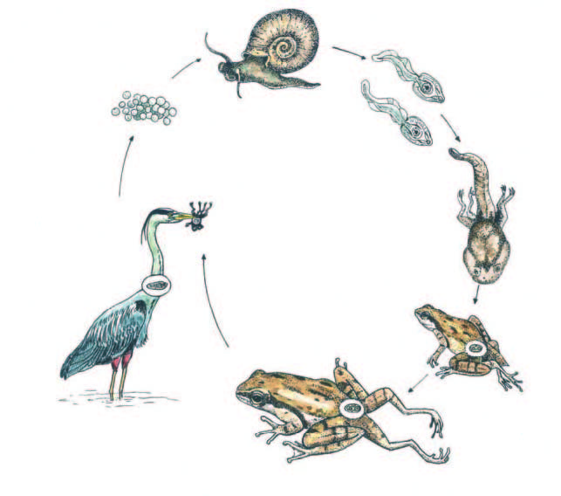

Slide 13
Q2. evolution of the trematode life cycle
Trematodes have wild life cycles, and you might find yourself thinking: how and why would such a complex, precarious, fragile thing evolve?
Propose a solution. How might the complex life cycle of the trematodes have evolved from something simpler? What selective pressures might have driven the evolution of the complex life cycle?
Work out the answer on your own.
Then share your answer with the class.

Slide 14
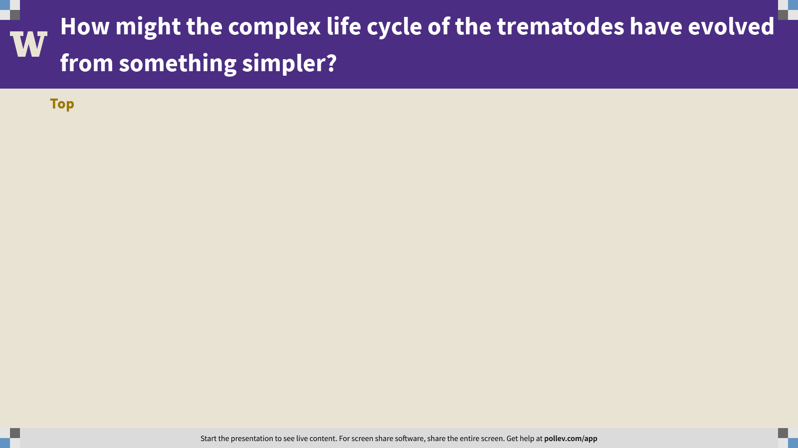
Notes:
How might the complex life cycle of the trematodes have evolved from something simpler?
https://www.polleverywhere.com/discourses/QGA7vW5mB7q6NN4hnnoGO

Slide 15
Practical session 2: Adaptations to parasitism and introduction to the trematodes

