Slide 1
Practical session 22: The apicomplexan Plasmodium

Slide 2
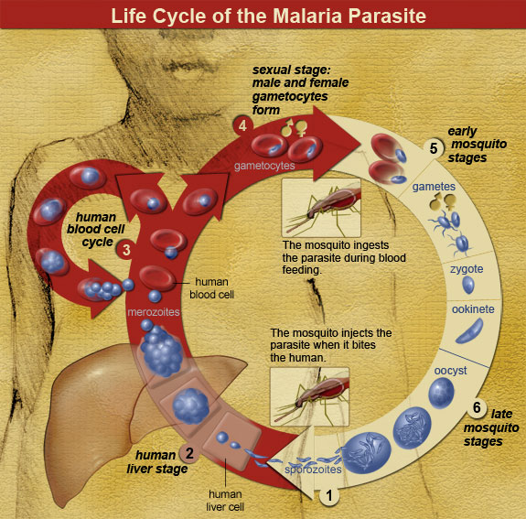

Q1. who is the definitive host of Plasmodium?
Now that you know the malaria life cycle, identify the definitive host. The answer might not be as straightforward as you think, so carefully review the life cycle to figure it out.
Ponder on your own (2 m), discuss with your group
(3 m), then share with the class (7 m).

Slide 3
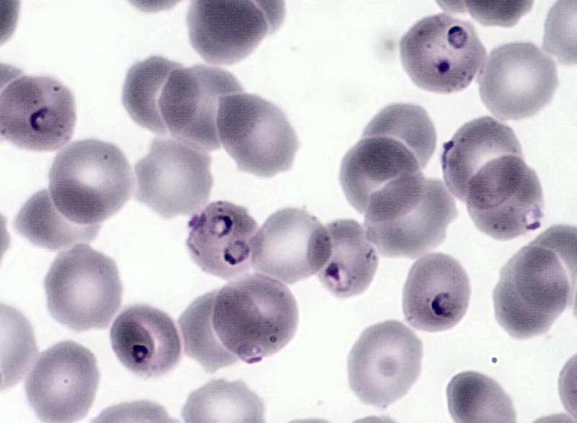
Q2. a synchronized attack
The recurring fevers of malaria result of cycles of schizogony that are synchronized across among many Plasmodium individuals. How might they synchronize their attack? Why might they synchronize their attack?
Ponder on your own (2 m), discuss with your group
(3 m), then share with the class (7 m).

Slide 4
Q2. a synchronized attack
Notes:
Changes in any attribute of a population over time.
Evolutionary change leads to adaptation and must involve a change in the frequency of individual genes in a population from generation to generation.

Slide 5
Q3. Name all the possible approaches to malaria control that you can think of, no matter how off-beat.

Slide 6

Notes:
Name all the possible approaches to malaria control that you can think of, no matter how off-beat.
https://www.polleverywhere.com/free_text_polls/vsf2KQkyvrM1PaFnc4kyp

Slide 7
Practical session 22: The apicomplexan Plasmodium

