Slide 1
Practical session 23: Abridged bacteria and viruses

Slide 4

Q1. what did Contagion get right?
Contagion was made a decade ago (in 2011) and it described a global pandemic of a zoonotic disease. What parts of Contagion match what you’ve observed in the COVID-19 pandemic? Where do the arcs of Contagion and COVID diverge?
Ponder on your own (2 m), discuss with your group
(3 m), then share with the class (7 m).

Slide 5
Q1. what did Contagion get right?
Notes:
Changes in any attribute of a population over time.
Evolutionary change leads to adaptation and must involve a change in the frequency of individual genes in a population from generation to generation.

Slide 6
Q2. is Steven Soderbergh psychic?
A LOT of Contagion seems to line up with the observed arc of the COVID-19 pandemic. How did Steven Soderbergh (the director of Contagion) make such accurate predictions?
Ponder on your own (2 m), discuss with your group
(3 m), then share with the class (7 m).

Slide 7
Q2. is Steven Soderbergh psychic?
Notes:
Changes in any attribute of a population over time.
Evolutionary change leads to adaptation and must involve a change in the frequency of individual genes in a population from generation to generation.

Slide 8
Q3. In the midst of COVID, let’s not forget about the many neglected diseases caused by viruses, bacteria, AND helminths.

Slide 9
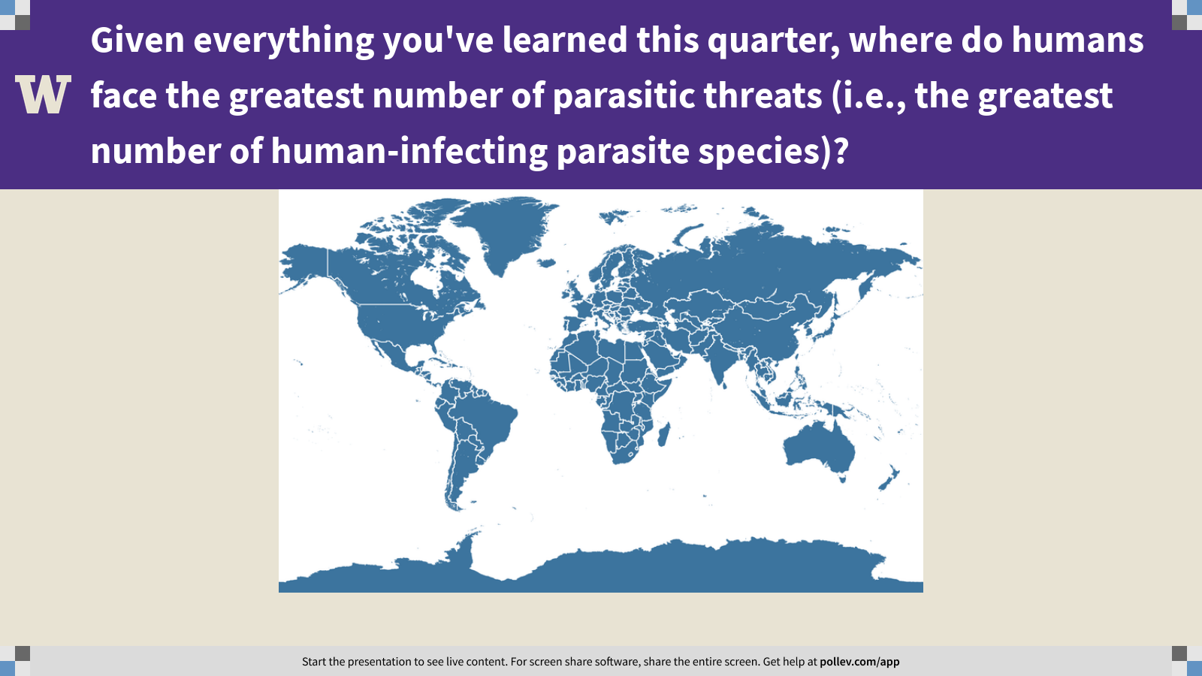
Notes:
Given everything you've learned this quarter, where do humans face the greatest number of parasitic threats (i.e., the greatest number of human-infecting parasite species)?
https://www.polleverywhere.com/clickable_images/h9FEll383XlXfOP4Cr7fQ

Slide 11
Practical session 23: Abridged bacteria and viruses

