Slide 1
Practical session 24: Parasites – who cares?

Slide 2
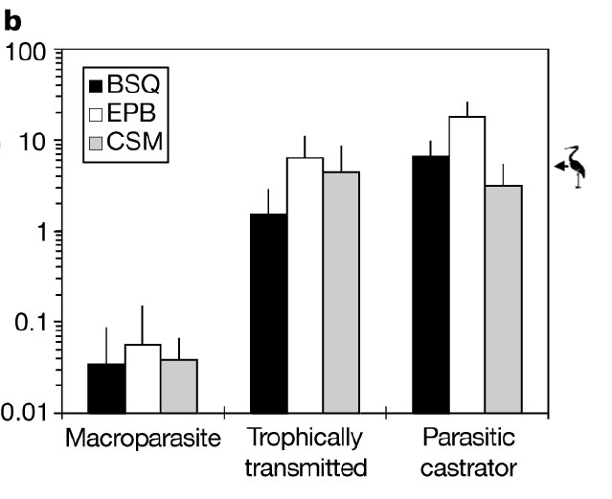

Q1. where are all the “typical” parasites?
When Armand Kuris and his colleagues tallied up all of the parasite biomass in three salt marshes, they found that the trophically transmitted parasites and the parasitic castrators had WAY more biomass than the “typical” parasites. Why?
Ponder on your own (2 m), discuss with your group
(3 m), then share with the class (7 m).

Slide 3
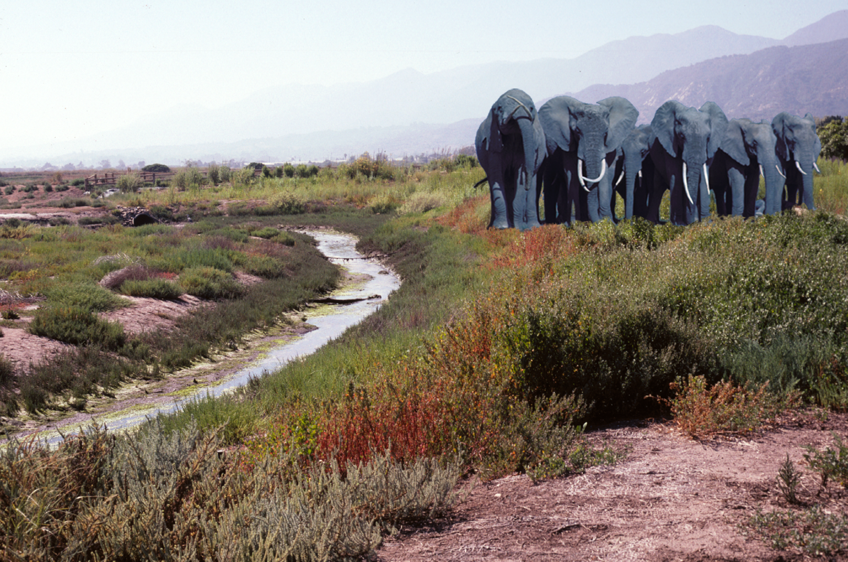
Q2. where should parasites be most/least energetically important?
You saw in the online lectures that parasites make up a large proportion of total biomass in three west coast salt marshes. But this probably isn’t true in every ecosystem. What is it about salt marshes that makes parasites important players there? In what other ecosystems would you expect parasites to attain high biomass? Where should they attain only low biomass? Think deeply and creatively.
Ponder on your own (2 m), discuss with your group
(3 m), then share with the class (7 m).

Slide 4
Q2. where should parasites be most/least
energetically important?
Notes:
Changes in any attribute of a population over time.
Evolutionary change leads to adaptation and must involve a change in the frequency of individual genes in a population from generation to generation.

Slide 5
ecosystems where parasites probably play an important energetic role:

Slide 6
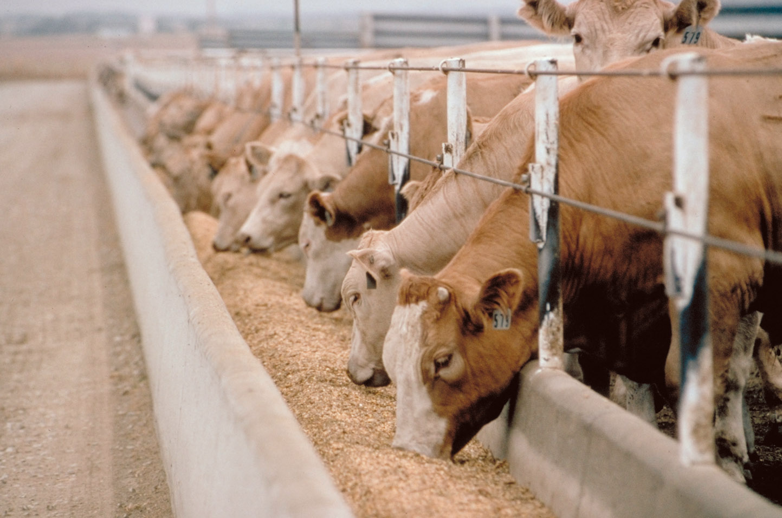
high host density

Slide 7

high host density

Slide 8

high host density

Slide 9
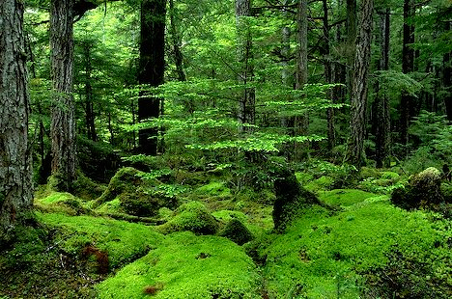
ancient, undisturbed ecosystems

Slide 10
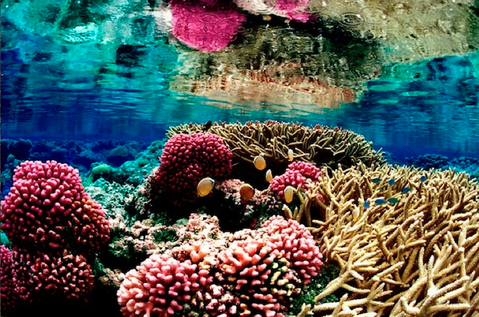
ancient, undisturbed ecosystems

Slide 11
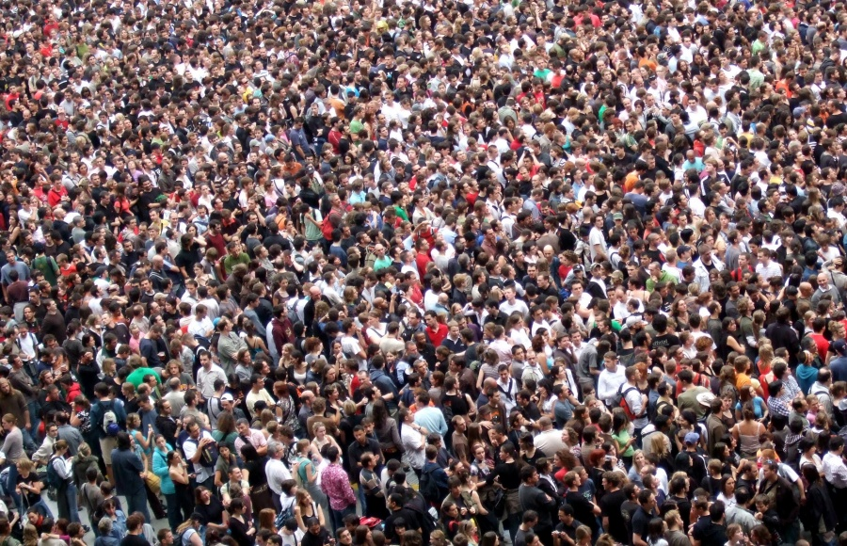
humans

Slide 12
ecosystems where parasites probably DO NOT play an important energetic role:

Slide 13
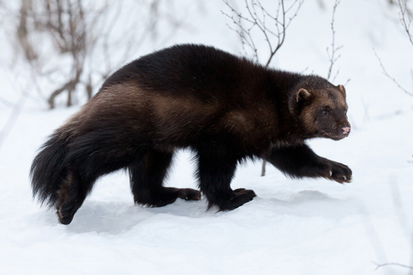
low host density

Slide 14
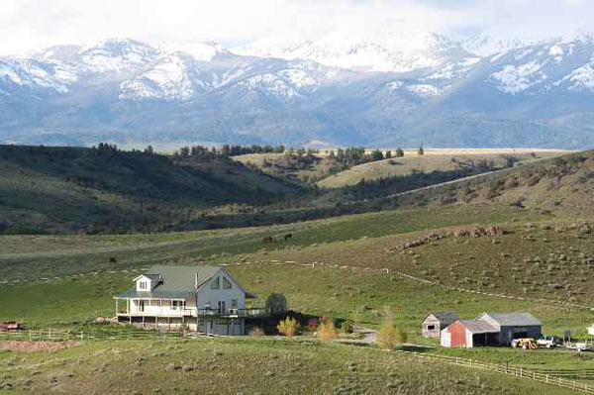

Slide 15
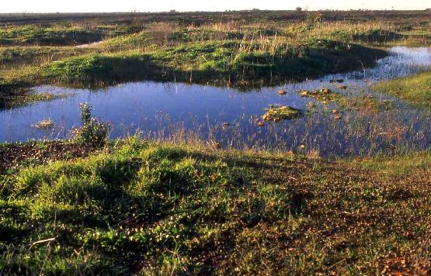
ephemeral environments

Slide 16
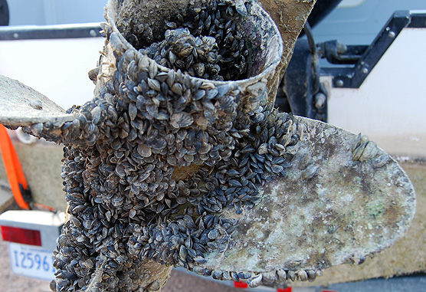
highly invaded ecosystems

Slide 17
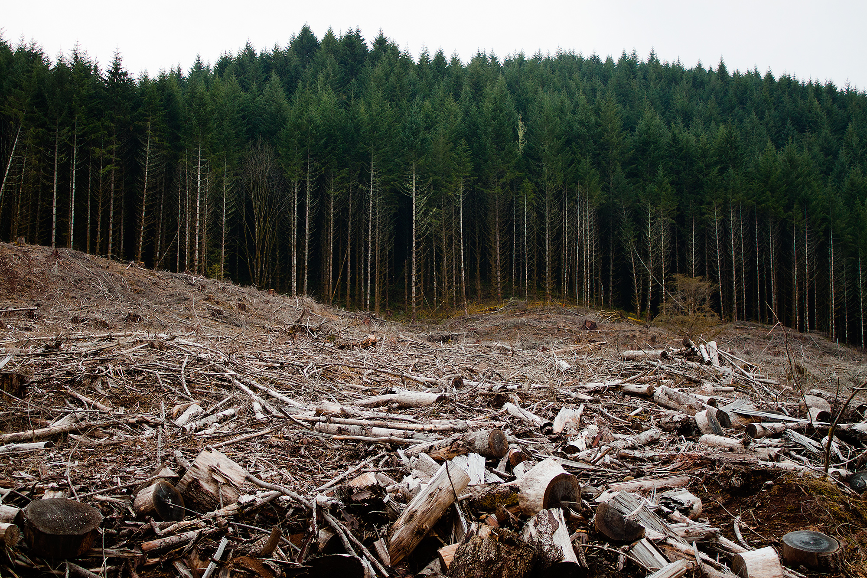
disturbed ecosystems

Slide 18
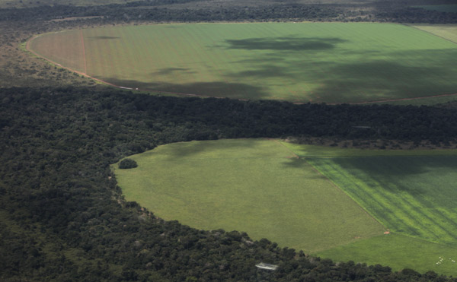
disturbed ecosystems

Slide 19
Q3. Today, we’ve only talked about ONE reason why parasites are ecologically important (i.e., their energetic importance). What are some OTHER ways in which parasites can influence communities and ecosystems?

Slide 20
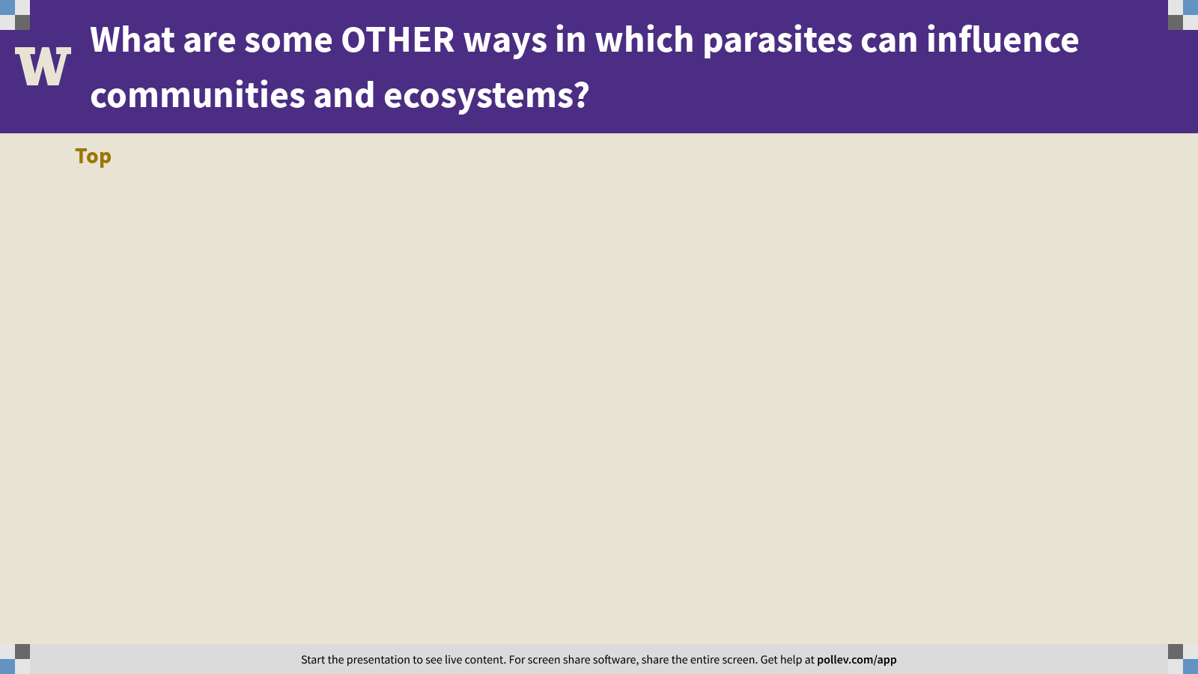
Notes:
What are some OTHER ways in which parasites can influence communities and ecosystems?
https://www.polleverywhere.com/discourses/4VcBgPoUI5LtJNyBUFVZp

Slide 21
Practical session 24: Parasites – who cares?

