Slide 1
Practical session 25: Nature’s services, nature’s disservices

Slide 2

Q1a. how does the abundance of
human parasites respond to conservation?
You read Wood et al. 2017 in preparation for this practical session, but the figure at left is tricky to interpret. Take a second look. Go back to the paper if you need to. How would you explain this figure to a colleague? What does it say about how the abundance of human parasites response to urbanization? To conservation?
Food-borne trematodiasis
Ponder on your own (2 m), discuss with your group
(3 m), then share with the class (7 m).

Slide 3
spatial
temporal
zoonotic and vector-borne
Food-borne trematodiasis
directly transmitted
(Wood et al. 2017, Phil Trans Roy Soc B)

Slide 4
Q1b. how does the abundance of human parasites respond to conservation?
Another tricky figure from Wood et al. 2017 is presented at left. Take a second look. Go back to the paper if you need to. How would you explain this figure to a colleague? What does it say about how the abundance of human parasites response to urbanization? To conservation? How is this figure related to the first one we discussed today?
Ponder on your own (2 m), discuss with your group
(3 m), then share with the class (7 m).

Slide 5
temporal result
(mean effect of factor on change in disease burden 1990–2010)
spatial result (mean effect of factor on disease burden in 2010)
(Wood et al. 2017, Phil Trans Roy Soc B)

Slide 6
Q2a. Okay, so it looks like conservation might have weak and variable effects on the transmission of human parasites. Which parasite species would you predict might have a positive response to conservation? In your answer, please briefly explain why!

Slide 7
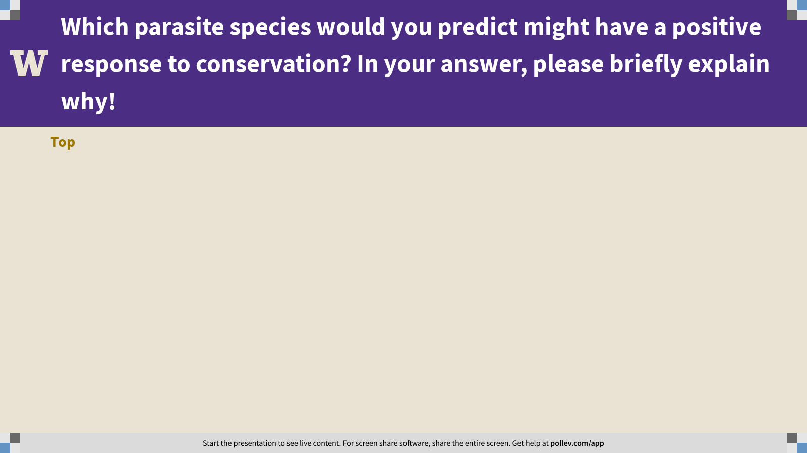
Notes:
Which parasite species would you predict might have a positive response to conservation? In your answer, please briefly explain why!
https://www.polleverywhere.com/discourses/Vlz6V7sBvFjlFJUGJN2jY

Slide 8
Q2a. Okay, so it looks like conservation might have weak and variable effects on the transmission of human parasites. Which parasite species would you predict might have a negative response to conservation? In your answer, please briefly explain why!

Slide 9

Notes:
Which parasite species would you predict might have a negative response to conservation? In your answer, please briefly explain why!
https://www.polleverywhere.com/discourses/D0xlamsHp37G4tIHnZ3fc

Slide 10
Practical session 25: Nature’s services, nature’s disservices

