Slide 1
Practical session 26: Your take-home messages

Slide 2
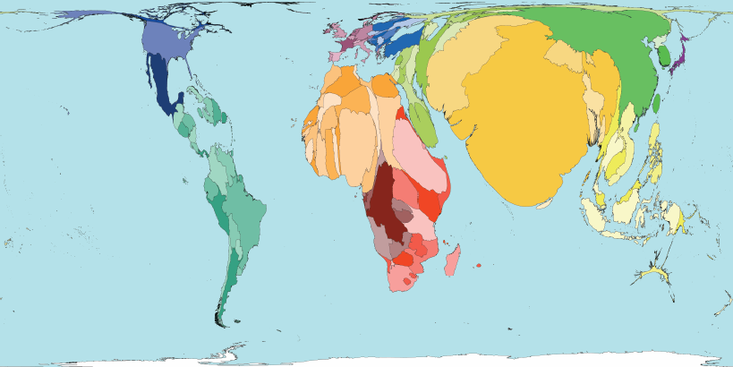

Q1. why the is the burden of human parasites high in the Global South?
We’ve already talked A LOT about poverty as a reason for why so much of the world’s infectious disease burden falls on the “Global South”, but there are also other contributing factors. Brainstorm as many as you can.
Ponder on your own (2 m), discuss with your group
(3 m), then share with the class (7 m).

Slide 3
Q2. What is one thing that you can do to help address NTDs in the developing world?

Slide 4
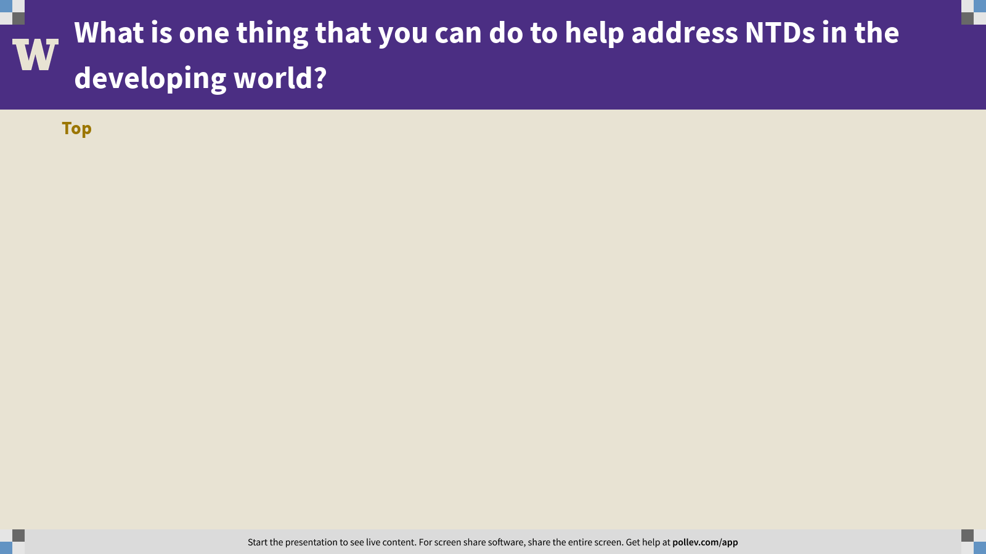
Notes:
What is one thing that you can do to help address NTDs in the developing world?
https://www.polleverywhere.com/discourses/62Kj9DbtjAqIwYQE02rDx

Slide 5
Q3. What is the FISH 406 concept that you were most excited to learn?

Slide 6
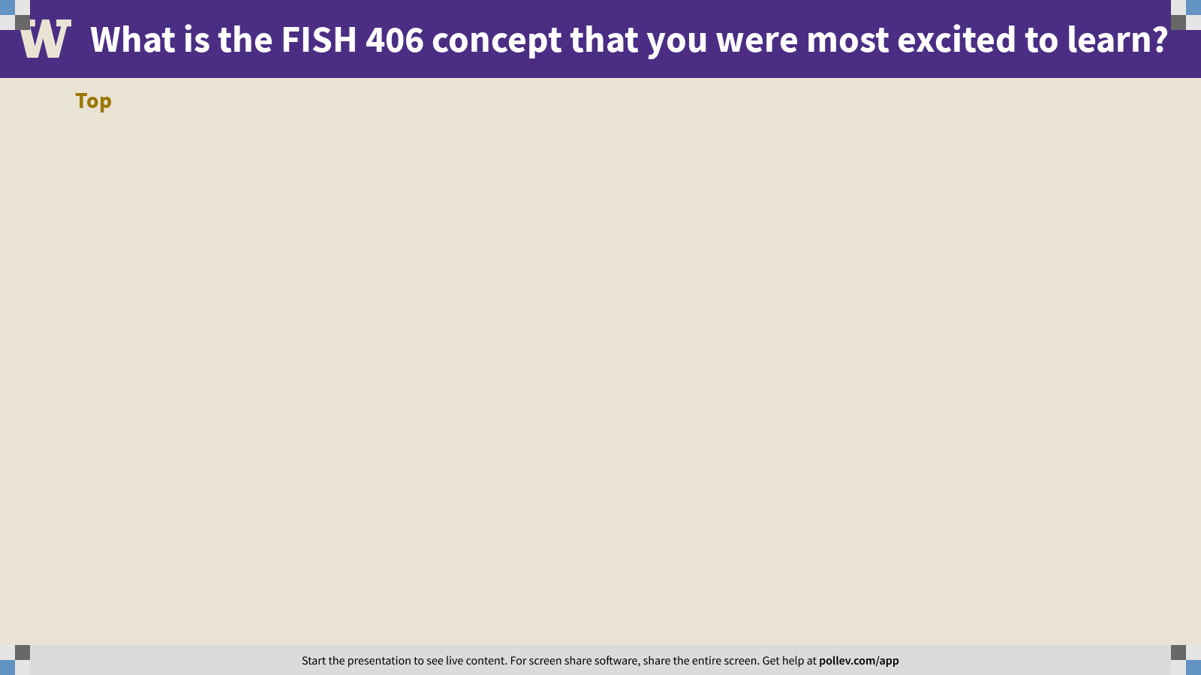
Notes:
What is the FISH 406 concept that you were most excited to learn?
https://www.polleverywhere.com/discourses/nm5Ont5j3D4ZRdZR8xwmM

Slide 7
Practical session 26: Your take-home messages

