Slide 1
Practical session 3: The trematodes

Slide 2

Q1. the theme
Trematode life cycles are variations on a theme. But before you can play the variations, you have to learn to play the theme.
Draw the typical, three-host trematode life cycle with a partner
Share your trematode art with the class
Work out the answer a partner.
Then share with the class.

Slide 3
Q2. the variations
Okay, so now that you know the trematode theme, I’d like you to improvise some variations.
Invent your own imaginary trematode.
Name it.
Draw its life cycle.
Explain how its life cycle varies from the trematode theme.
Explain why its life cycle varies from the trematode theme (i.e., what selective forces drove this departure from the norm?).
Work out the answer on your own.
Then compare answers with a partner.

Slide 4
Q3. the actual life cycles of actual trematodes

Slide 5
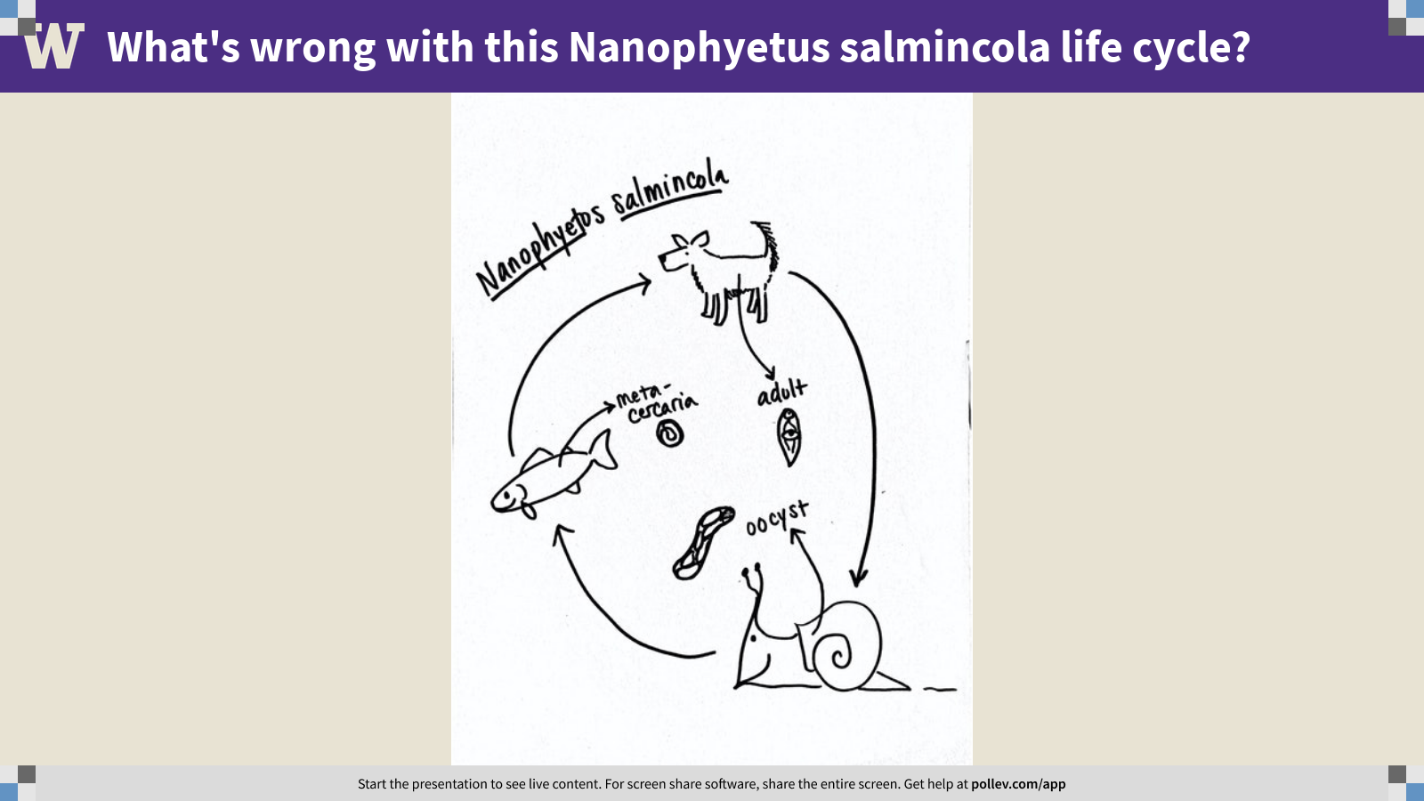
Notes:
What's wrong with this Nanophyetus salmincola life cycle?
https://www.polleverywhere.com/clickable_images/TVu34IP73ayWHVS9abZyN

Slide 7
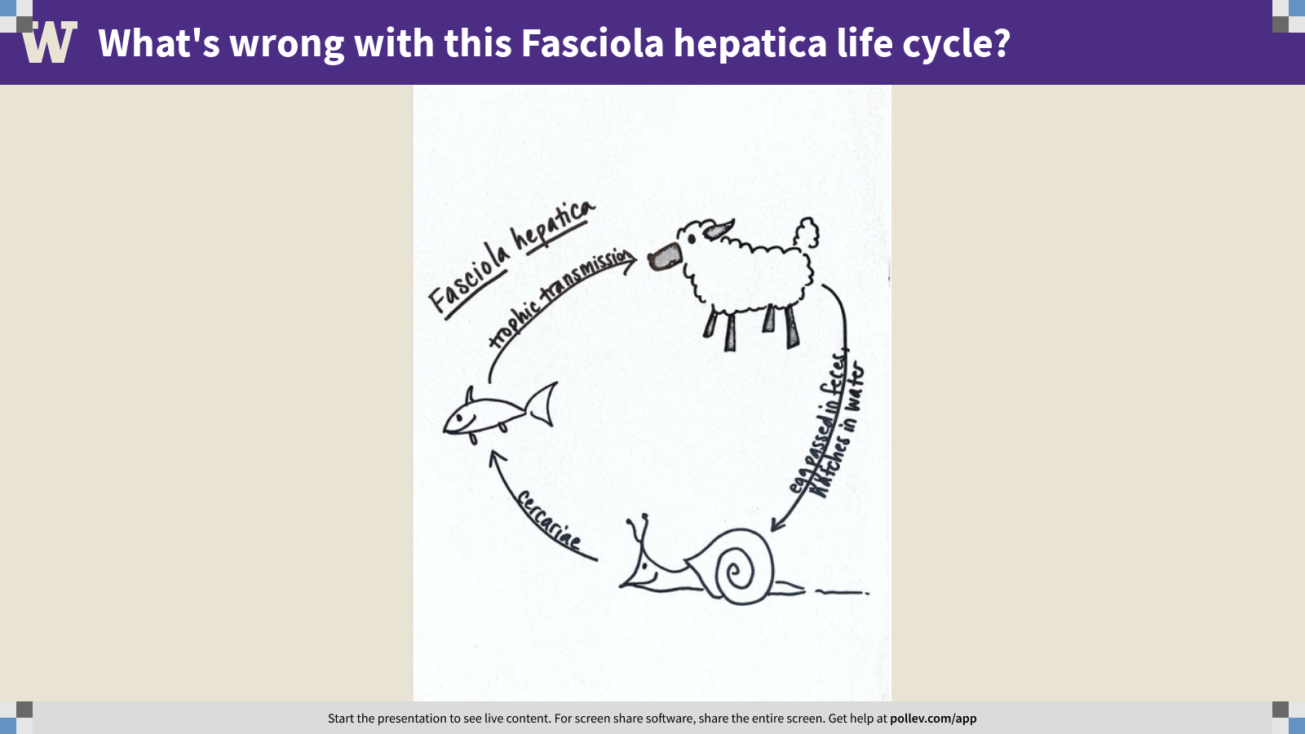
Notes:
What's wrong with this Fasciola hepatica life cycle?
https://www.polleverywhere.com/clickable_images/eT0KqwGQ8YfHbB1rflSdu

Slide 9
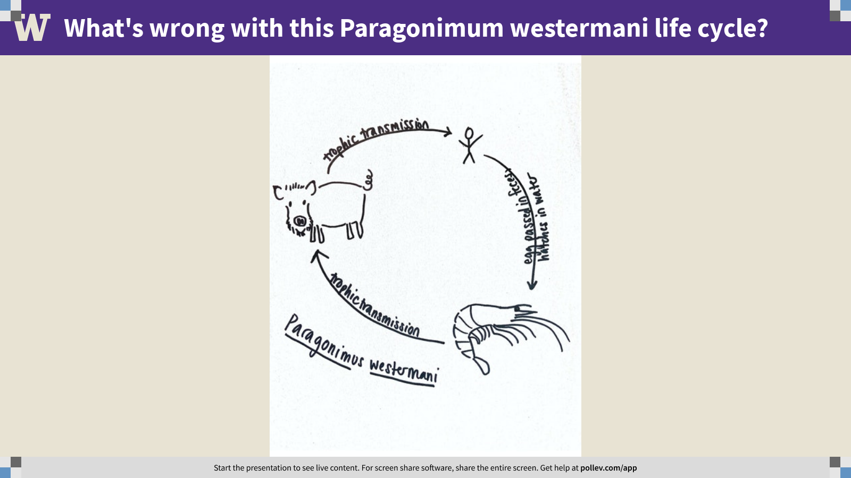
Notes:
What's wrong with this Paragonimum westermani life cycle?
https://www.polleverywhere.com/clickable_images/qLOf6RAR8PHkXKpQrV05p

Slide 11
Practical session 3: The trematodes

