Slide 1
Practical session 4: Schistosomes 1

Slide 2
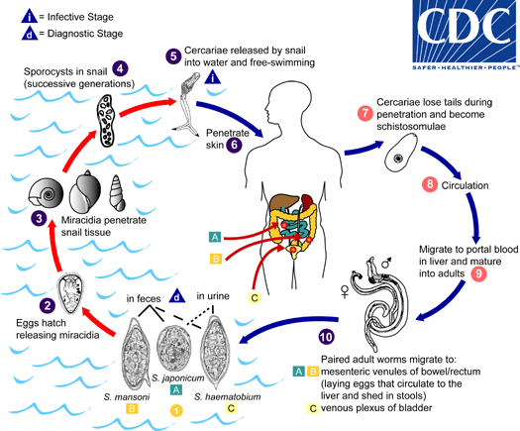

Slide 3
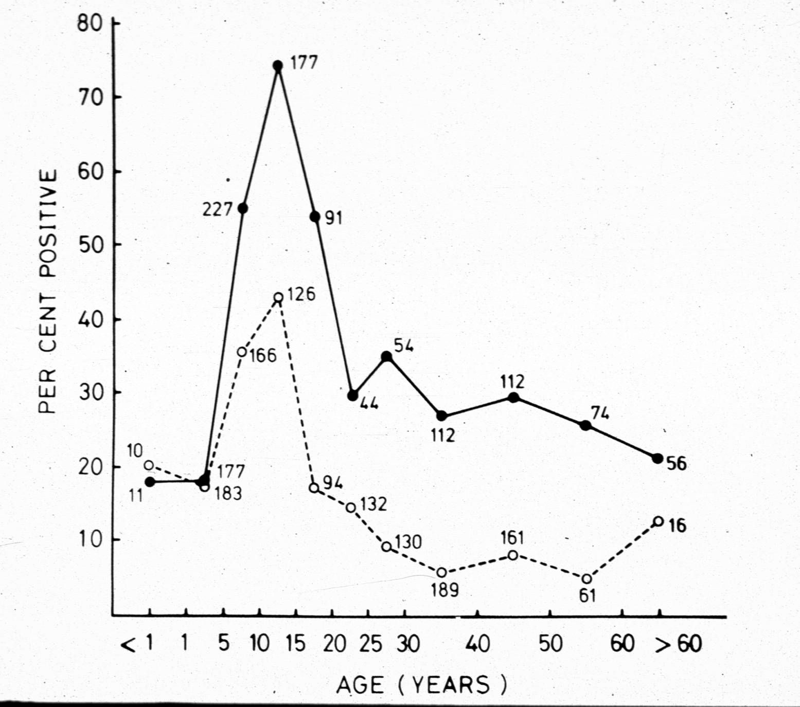

Q1. encounter and compatibility filters
At left is a plot showing the proportion of schistosome-positive individuals among a sample of villagers in sub-Saharan Africa. The solid line represents males and the dashed line females.
Interpret this plot – what does it tell you about who is infected and who is not?
Why is there such a big difference between males and females? Think about the encounter and compatibility filters we discussed in a previous lecture.
Ponder on your own (5 m), discuss with a
partner (5 m), then share with the class (5 m).

Slide 4
(Combes 1990)

Slide 5
(Combes 1990)

Slide 6
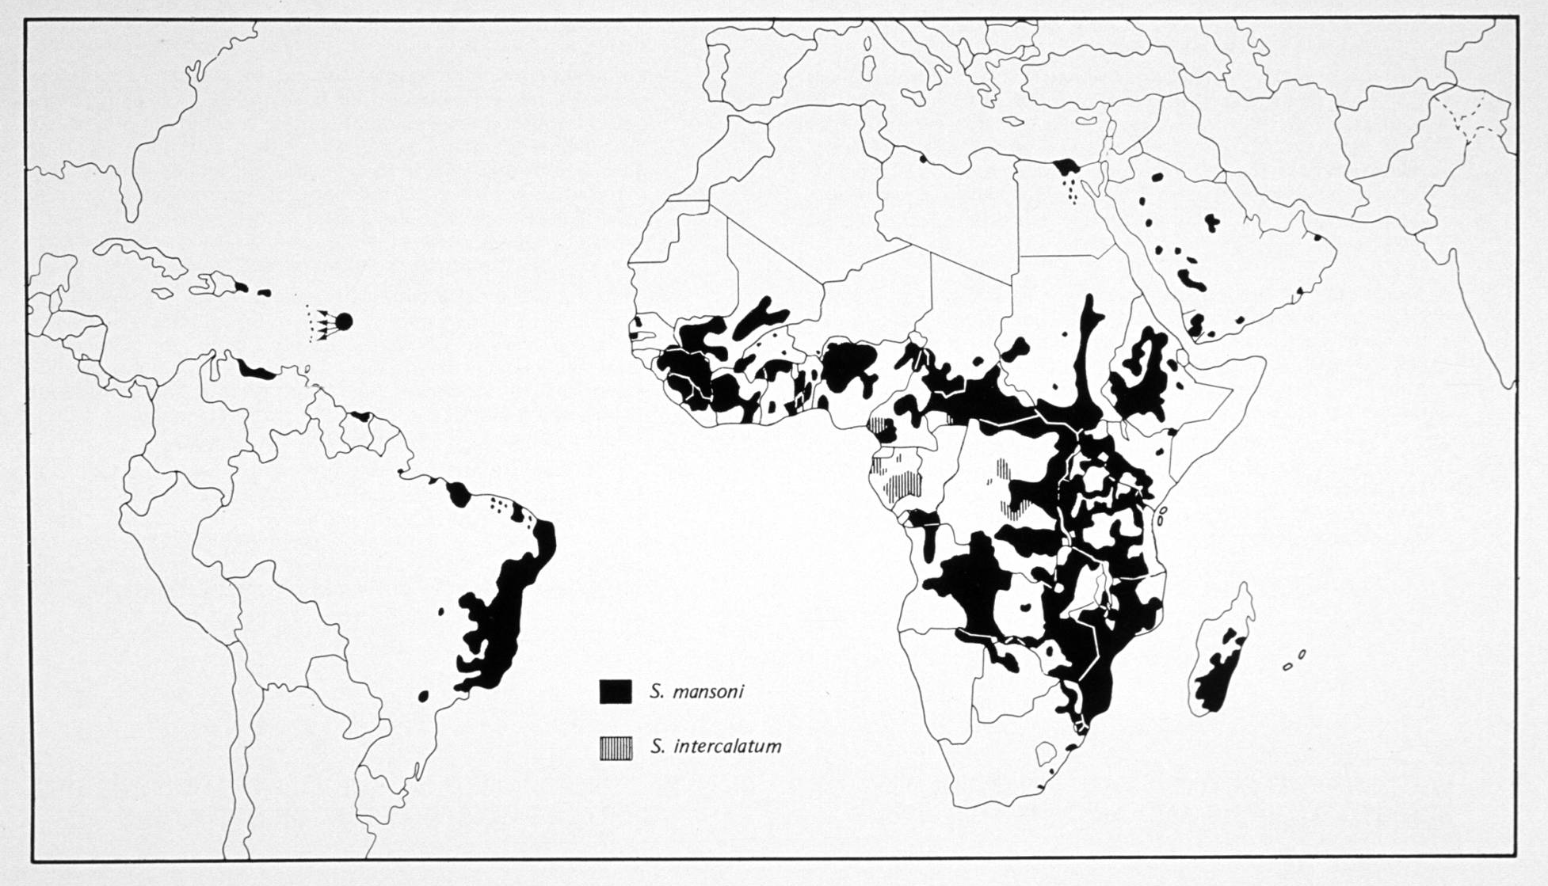
S. mansoni was introduced from Africa into South America and the Carribbean via the Atlantic slave trade.
S. haematobium was not.

Slide 7
(Sokolow et al. 2017)
Notes:
This is the global distribution of cases. Worldwide, there are about 200 million cases of schistosomiasis. That makes this the world’s second most prevalent parasitic disease, after malaria. And the vast majority of these cases are concentrated in sub-Saharan Africa.

Slide 9
Q2. Why wasn’t S. haematobium introduced into South American and the Caribbean
with S. mansoni?

Slide 10
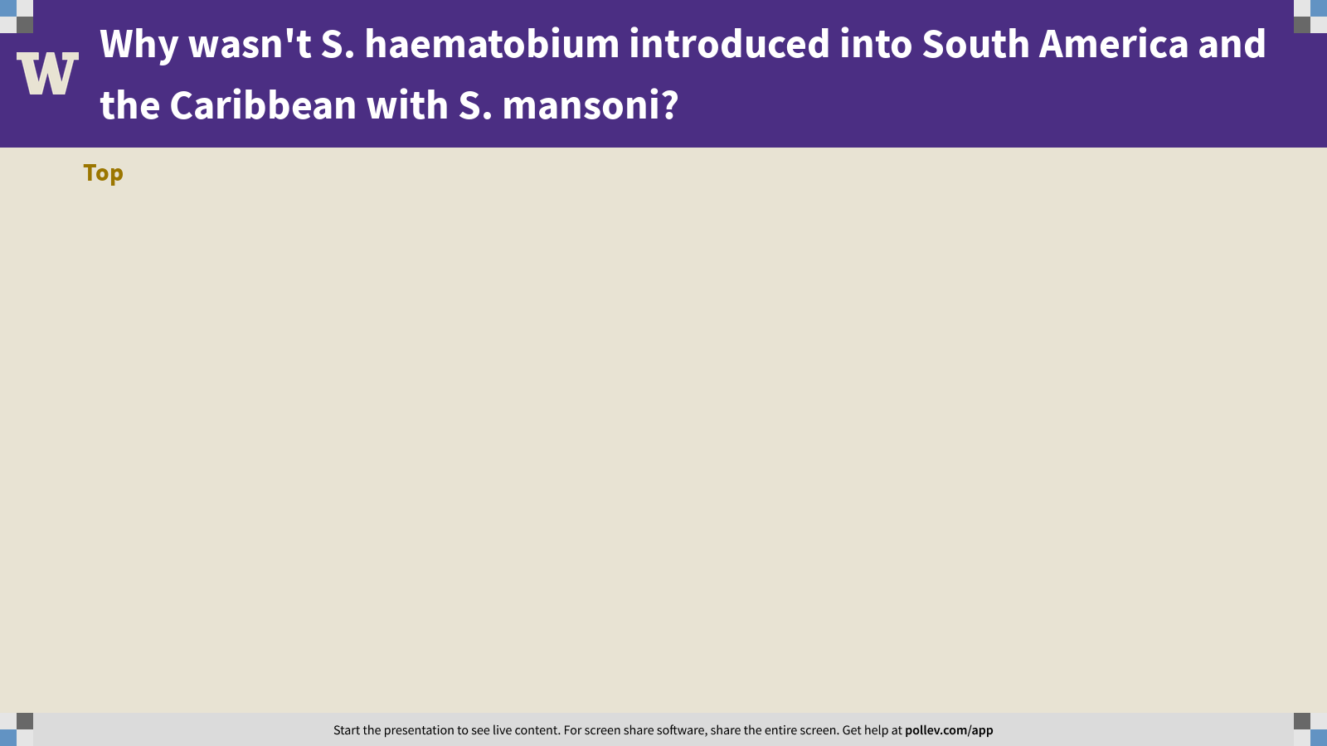
Notes:
Why wasn't S. haematobium introduced into South America and the Caribbean with S. mansoni?
https://www.polleverywhere.com/discourses/elViVszOyAjaOOxNT0yDq

Slide 11
Q3. The negative fitness effects of schistosomes on their hosts largely arise from the host’s own immune response.
Can you think of other diseases where this is also the case?

Slide 12
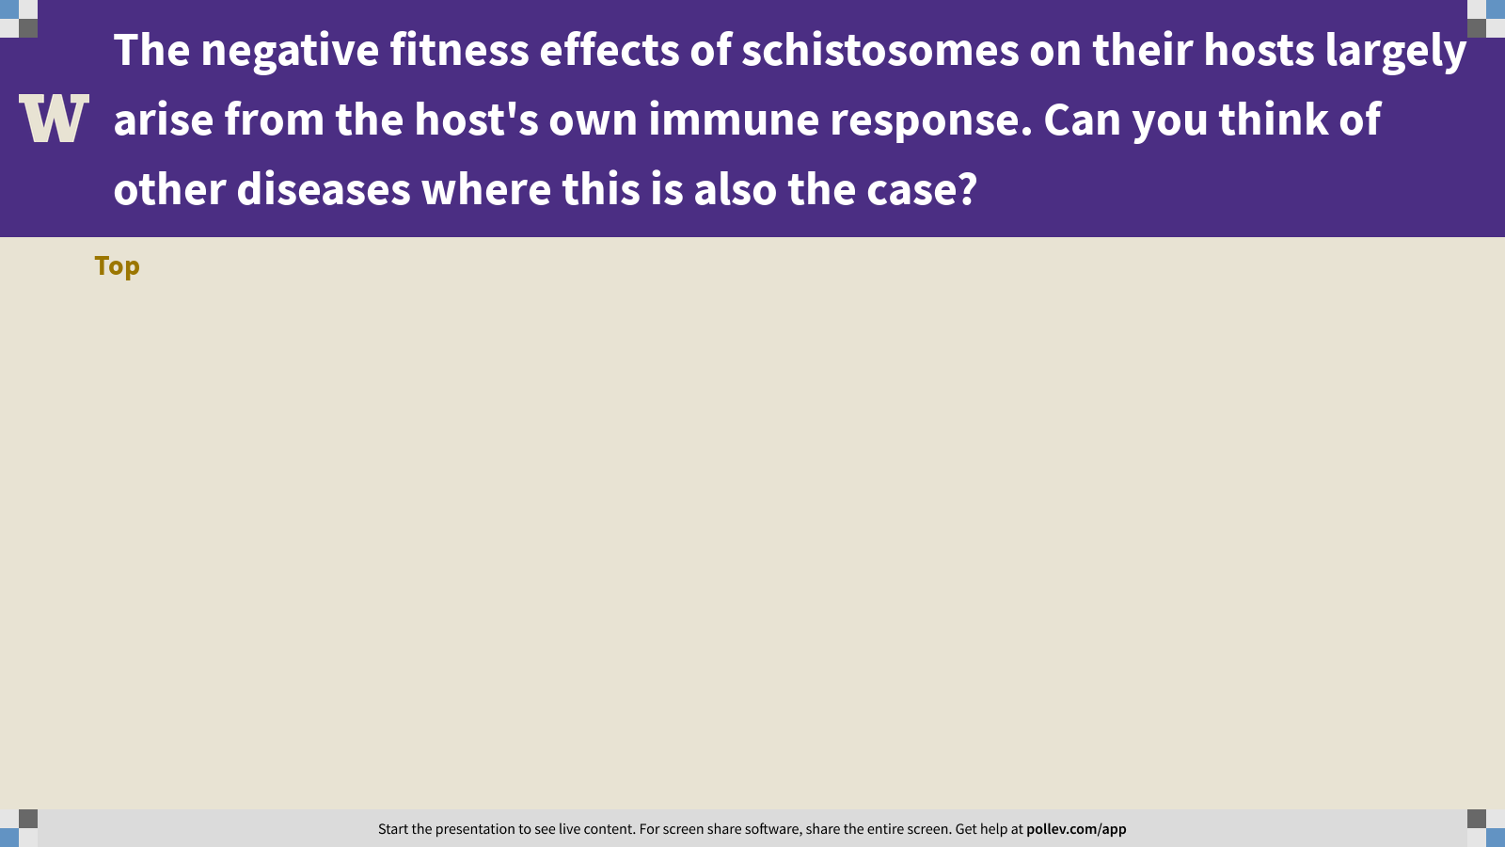
Notes:
The negative fitness effects of schistosomes on their hosts largely arise from the host's own immune response. Can you think of other diseases where this is also the case?
https://www.polleverywhere.com/discourses/gxhVlkGEZflGK4c5MzSpM

Slide 13
Practical session 4: Schistosomes 1

