Slide 1
Practical session 7: Cestodes 1

Slide 2
Q1. point to the oldest proglottid

Slide 3
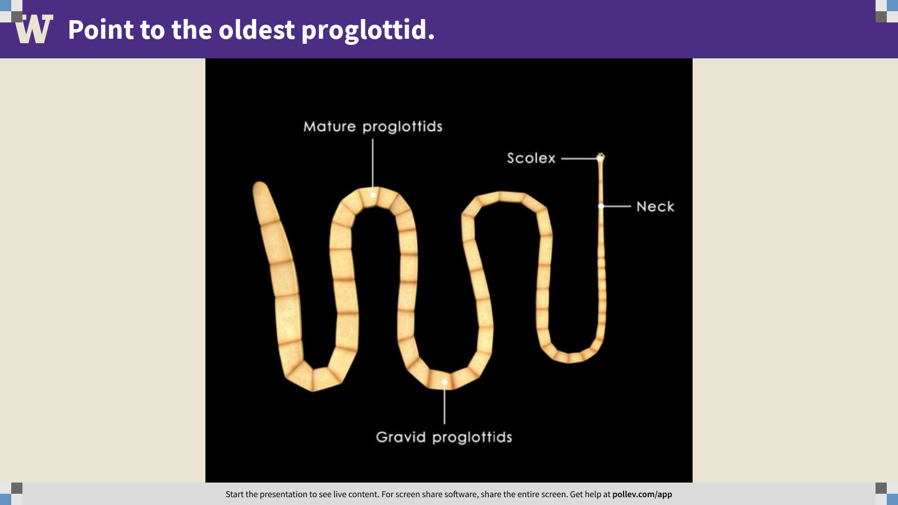
Notes:
Point to the oldest proglottid.
https://www.polleverywhere.com/clickable_images/EQEMkeN9T71ynIOLZce9T

Slide 4
Q2. point to the digestive tract

Slide 5
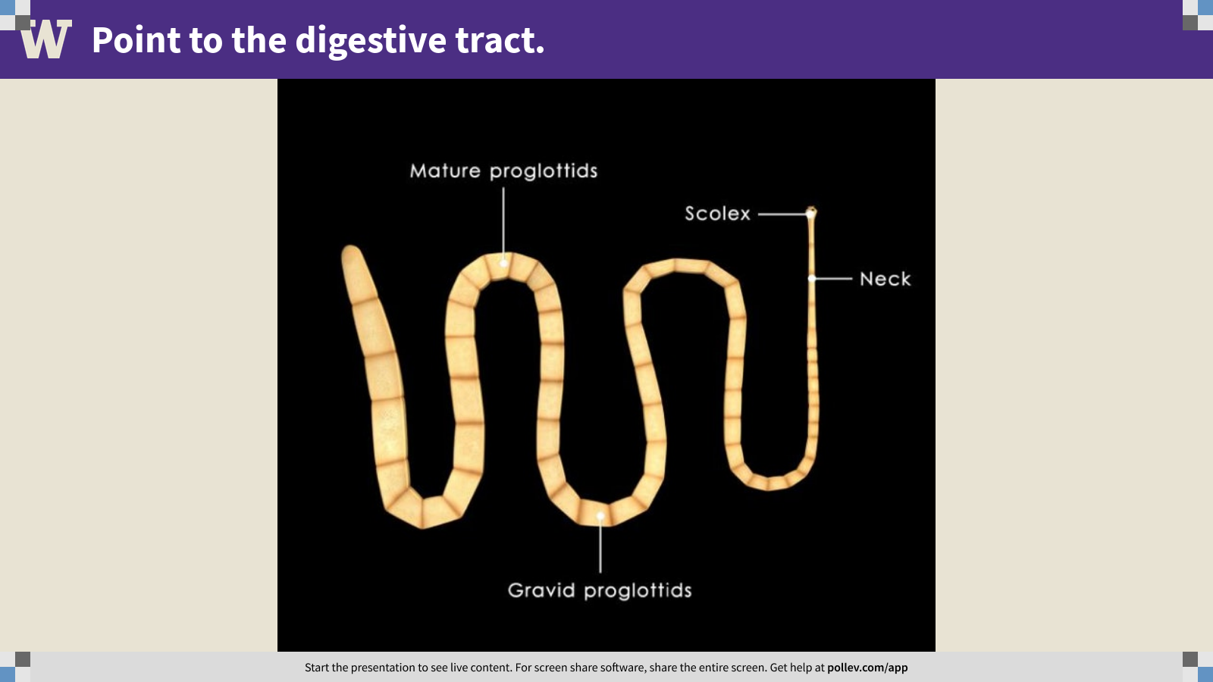
Notes:
Point to the digestive tract.
https://www.polleverywhere.com/clickable_images/dlHV7n50yg4G6HPOKxAW7

Slide 6
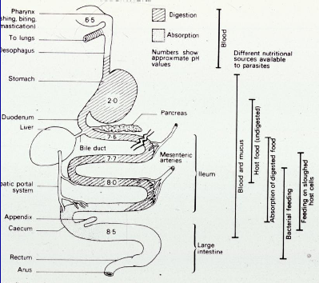
Q3. the vertebrate gut as habitat

Slide 7

Q3. the vertebrate gut as habitat
Imagine you are a tapeworm. Where would you choose to live and why?
Ponder on your own (5 m), discuss with a group (5 m), then share with the class (5 m).

Slide 8
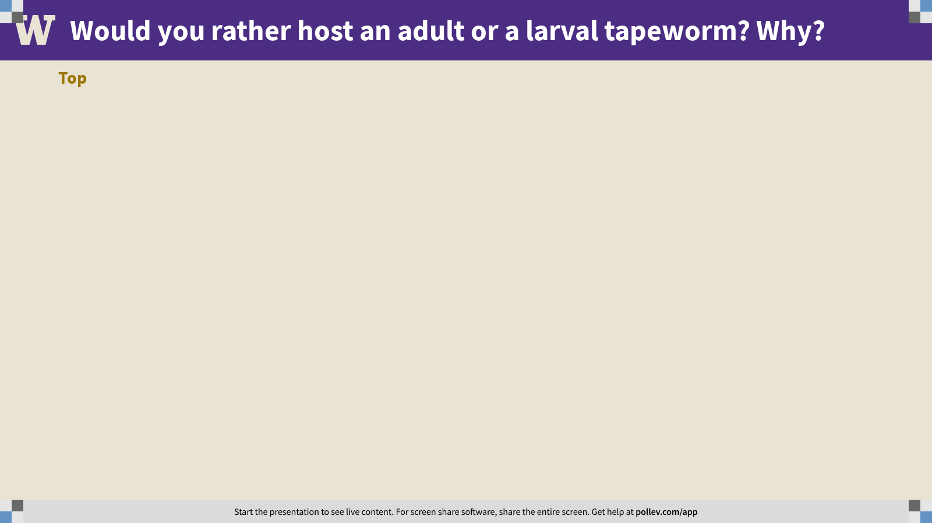
Notes:
Would you rather host an adult or a larval tapeworm? Why?
https://www.polleverywhere.com/discourses/FtkP0cIh2zy4AQp5qS0Vy

Slide 9
Q5. crowding effects?
A coroner keeps track of the distributions of two (made-up) tapeworms that occupy the intestines of bodies sent for autopsy. She counts the number of tapeworms with scolices attached in different sections of the intestinal tract (jejunum -> ileum -> ascending colon -> transverse colon ->descending colon). The table shows the distribution of worms she recovers. Is there evidence for interspecific competition?
Ponder on your own (5 m), discuss with a partner (5 m), then share with the class (5 m).

Slide 10
Practical session 7: Cestodes 1

