Slide 1
Practical session 8: Cestodes 2

Slide 2
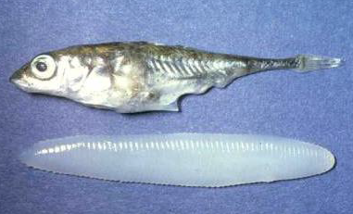
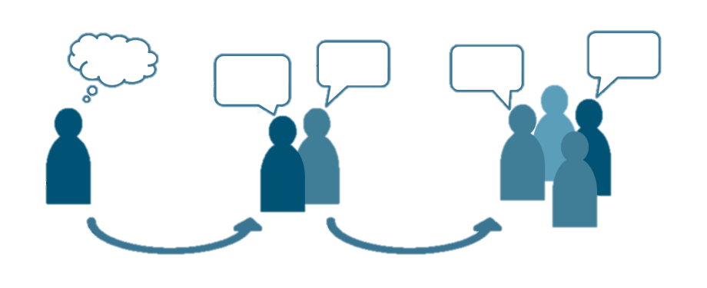
Q1. Schistocephalus solidus
Plerocercoids of the pseudophyllidean tapeworm Schistocephalus solidus are enormous wrt their hosts. Why?
Ponder on your own (5 m), discuss with a group (5 m), then share with the class (5 m).

Slide 3
Q2. The Pseudophyllidea and the Cyclophyllidea tend to be freshwater and terrestrial parasites, respectively. How do their respective life cycles reflect these habitat differences?

Slide 4
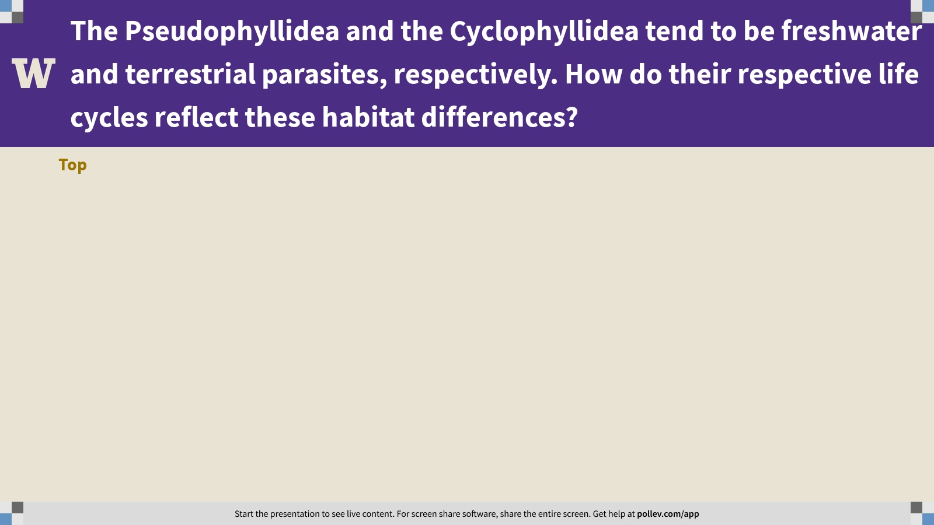
Notes:
The Pseudophyllidea and the Cyclophyllidea tend to be freshwater and terrestrial parasites, respectively. How do their respective life cycles reflect these habitat differences?
https://www.polleverywhere.com/discourses/NinTTlwxhVPaQsdt4Am0z

Slide 5
Q3. Taenia solium
There are two ways for humans to become infected with Taenia solium. Both are bad. Which one is worse and why?
Ponder on your own (5 m), discuss with a partner (5 m), then share with the class (5 m).

Slide 6
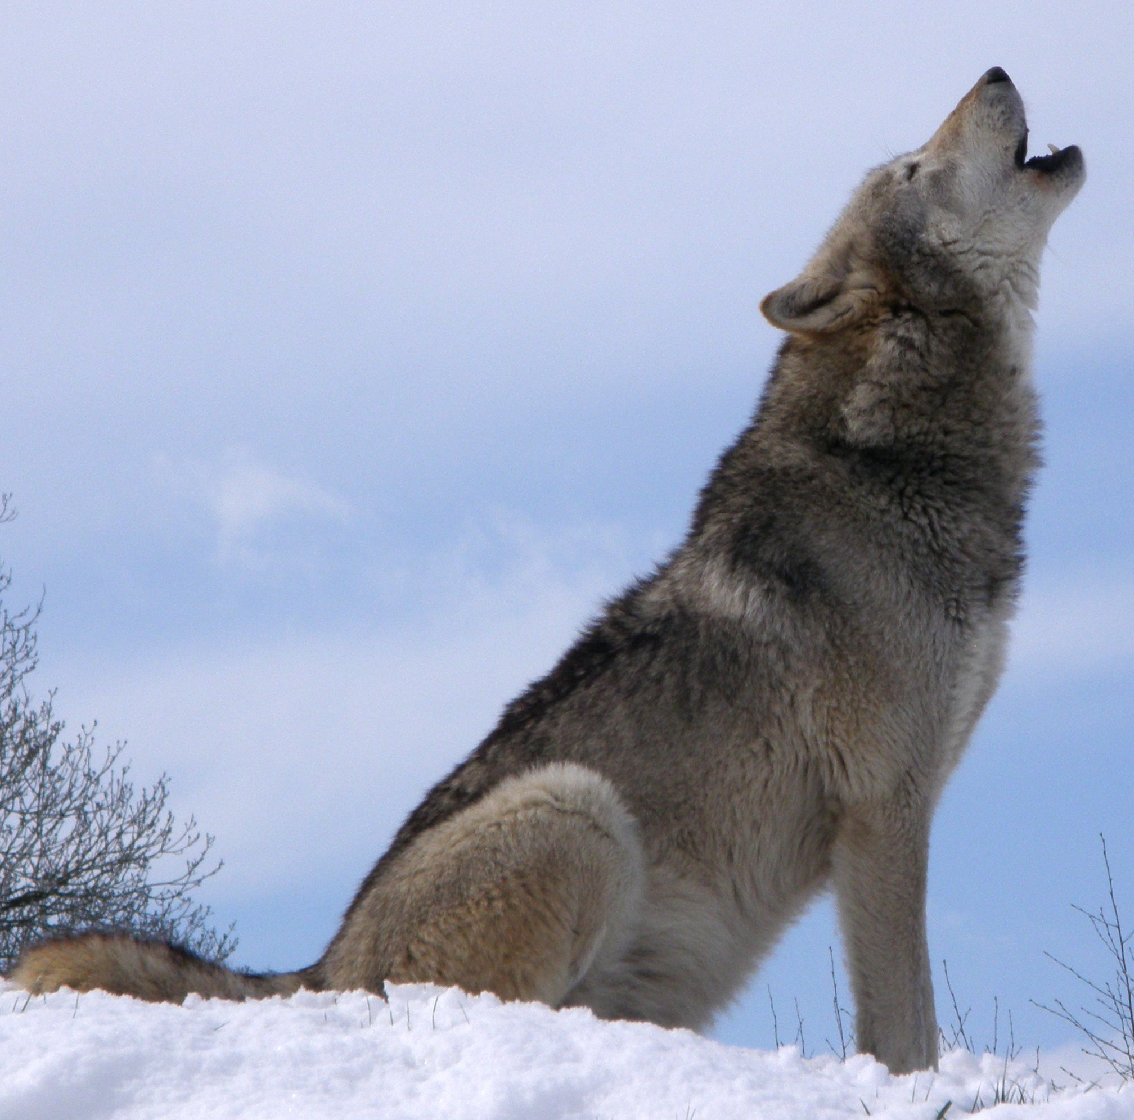
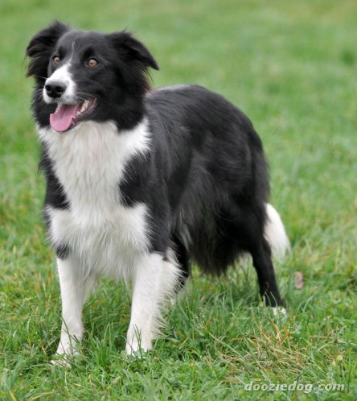
Q4. Echinococcus granulosus and E. multilocularis
There are separate pastoral/domestic and sylvatic cycles for both E. granulosus and E. multilocularis. Which do you think would be the easiest kind of life cycle to interrupt? Why? How would you do it?
Ponder on your own (5 m), discuss with a partner (5 m), then share with the class (5 m).

Slide 7
Practical session 8: Cestodes 2

