Slide 1
Practical session 9: Introduction to the nematodes

Slide 2

Dungeness crab
Metacarcinus magister
Notes:
One of Washington State’s most important commercial fisheries, bringing in millions of dollars per year,

Slide 3
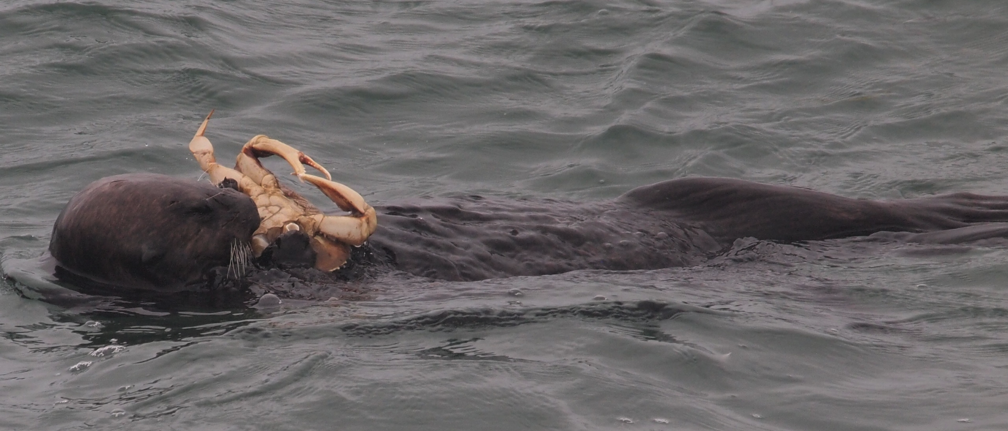
J Maughn
Notes:
And an integral part of many of Washington’s marine food webs. A lesser known fact about Dungeness crabs,

Slide 4
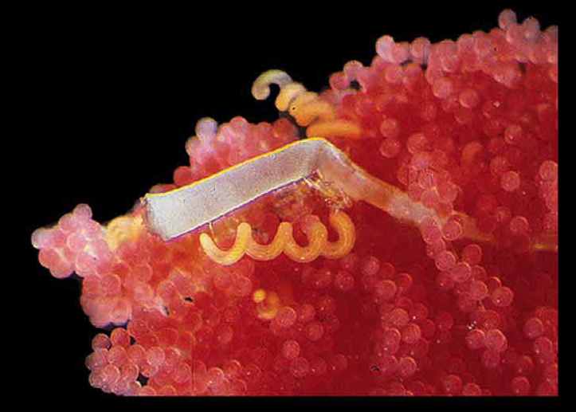
nemertean egg predators
Carcinonemertes spp.
(Sadeghian and Santos 2010 J Nat Hist)
Notes:
Is that they have several important parasites that may be influential enough to change their host’s population dynamics.
These are nemertean, or ribbon worm, parasites in the genus Carcinonemertes. They live on the exoskeleton of the crabs and invade the egg masses of ovigerous female crabs, where they then get about the business of eating as many crab eggs as possible.

Slide 5
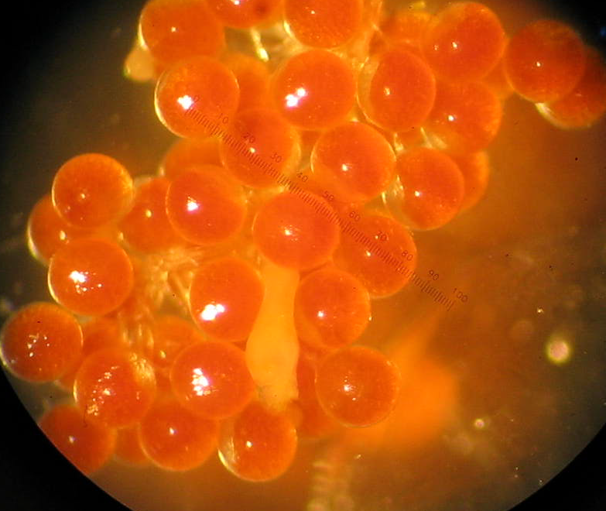
nemertean egg predators
Carcinonemertes spp.
Notes:
When I first began grad school, I actually considered working on these parasites. And this is some video that I took at that time. And though I didn’t end up working with Carcinonemertes, they’ve since remained in the back of my mind.
There are two interesting and unanswered questions that I’ve been thinking about that would make for productive collaborations within SAFS.

Slide 6
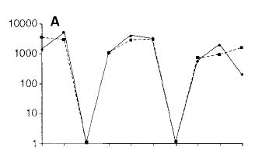
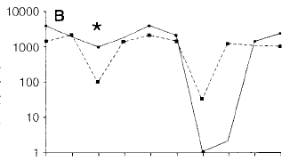
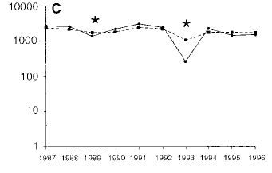
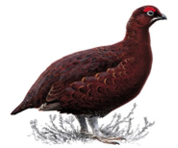
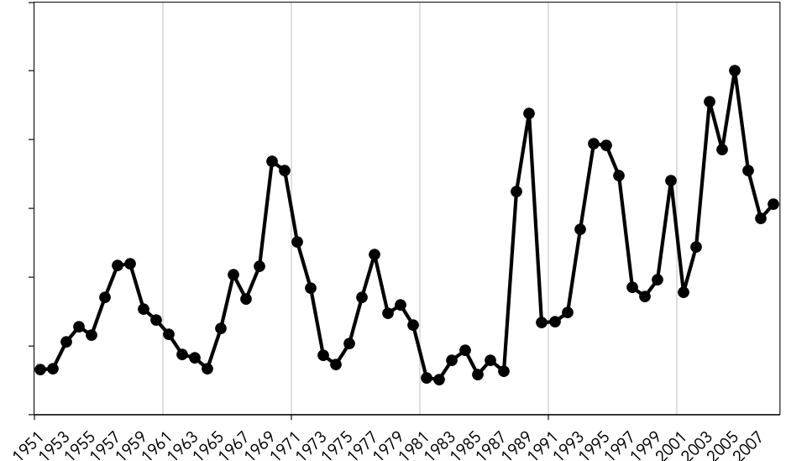
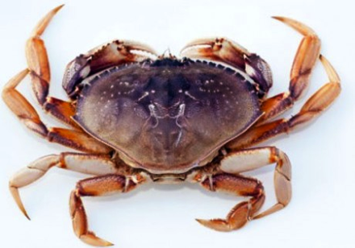
# grouse
30
(Hudson et al. 1998)
25
Dungeness crab landings (millions of pounds)
15
10
5
(WDFW 2009)
Notes:
The first has to do with the characteristic oscillations in Dungeness populations. Historically, there have been these large fluctuations in harvest. To the extent that these fluctuations represent real underlying changes in the population dynamics of the host,
It is possible that these oscillations are driven by density-dependent changes in parasite transmission, happening with a time delay. The classic example of this pattern comes from red grouse in northern England, which had have these huge boom-and-bust cycles that can be mitigated and then eliminated when the grouse are treated for their worm parasites.
I think that this question would leverage the theoretical ecology, economic, and fisheries management expertise within SAFS and make for an interesting and impactful project.

Slide 7

Q1. parasites as regulators of host populations
Imagine you are a fishery biologist at WDFW interested in understanding why Dungeness crab populations undergo boom and bust cycles. How would you proceed to test the hypothesis that Carcinonemertes causes these cycles?
Ponder on your own (5 m), develop a plan with your group (5 m), then share with the class (5 m).

Slide 8
Q1. parasites as regulators of host
populations
Notes:
Changes in any attribute of a population over time.
Evolutionary change leads to adaptation and must involve a change in the frequency of individual genes in a population from generation to generation.

Slide 9
Q2. Migration sometimes evolves in a host species to help hosts avoid parasites. Think about host species that undertake migrations. Which ones might do so to avoid parasites? Write the name of the host and parasite.

Slide 10
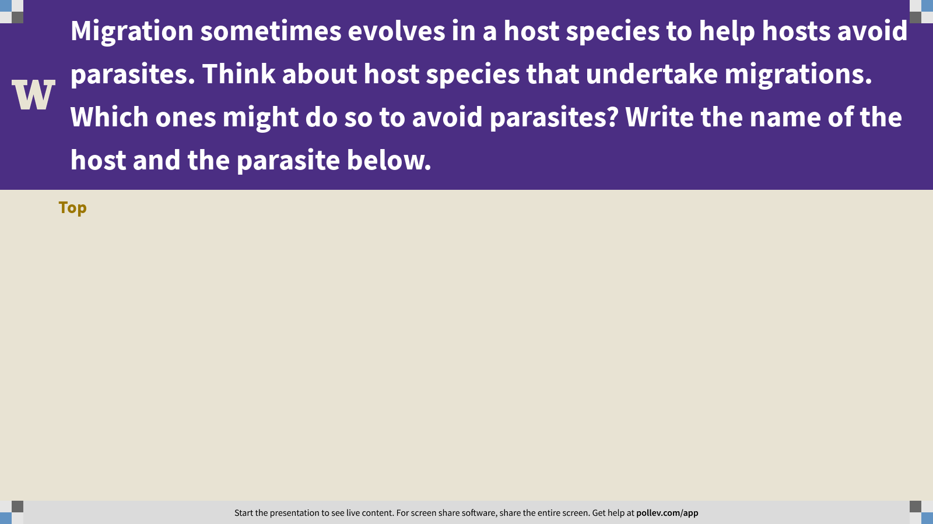
Notes:
Migration sometimes evolves in a host species to help hosts avoid parasites. Think about host species that undertake migrations. Which ones might do so to avoid parasites? Write the name of the host and the parasite below.
https://www.polleverywhere.com/discourses/SqPNtDbHJ8KzdmBaj8l5N

Slide 11
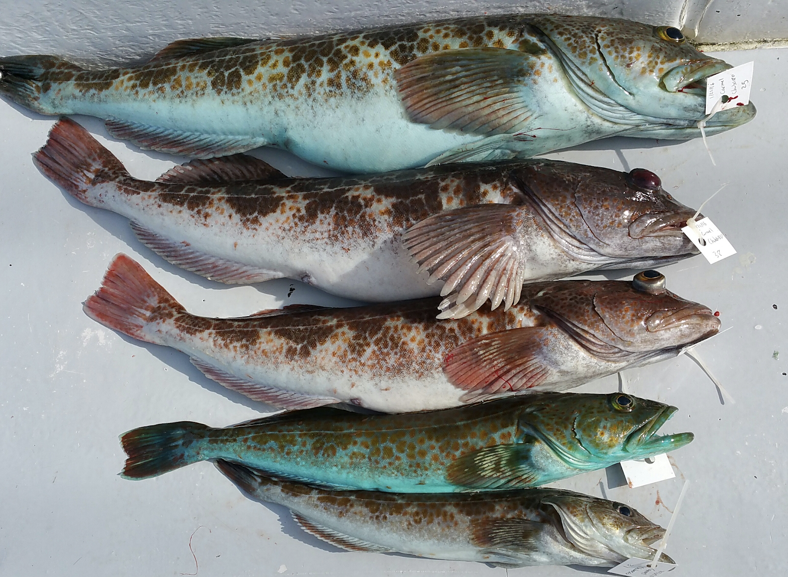
Q3. parasites and sexual selection
On the west coast of the US, lingcod occasionally exhibit a striking blue coloration. How would you test whether this coloration is related to sexual selection?
Ponder on your own (5 m), discuss with a partner (5 m), then share with the class (5 m).

Slide 12
Q3. parasites and sexual selection
Notes:
Changes in any attribute of a population over time.
Evolutionary change leads to adaptation and must involve a change in the frequency of individual genes in a population from generation to generation.

Slide 13
Practical session 9: Introduction to the nematodes

